Slide 1



Cross-country variation in financial inclusion: a global perspective
Mais Sha’ban Claudia Girardone Anna Sarkisyan
Essex Conference on Financial Inclusion 2020 — Mainstreaming financial inclusion
Essex Business School , November 6,2020

Slide 2
“Financial inclusion means that individuals and businesses have access to useful and affordable financial products and services that meet their needs – transactions, payments, savings, credit and insurance – delivered in a responsible and sustainable way.” (World Bank, 2018)

Slide 3
Background
Global commitment to advancing financial inclusion as a key enabler for 8 of the Sustainable Development Goals (SDGs) 2030 including; lower poverty, higher development, and equal opportunity
According to the World Bank there has been some improvement in financial inclusion as the share of adults owning an account increased from 51% in 2011 to 62% in 2014 and 69% in 2017
Progress has been mainly driven by government policies and the use of technology. However variation across countries is still very high
  For example in the Sub-Saharan Africa region the progress has been mainly achieved through new mobile accounts. In India, mainly through financial institutions
In addition financial inclusion is not just about having an account; the actual use is what matters for achieving the benefits of financial inclusion

Slide 4
Aims of Study
The heterogeneity in financial inclusion has highlighted the need for a multidimensional measure of financial inclusion that is comparable across economies to identify the current state, set targets and policies, and monitor progress
  In this study we construct a financial inclusion index that captures different dimensions: use, access, and depth of financial services. This is motivated by the inadequacy of focusing on a single measure to represent and summarise the extent of financial inclusion in a country
Additionally, high variation in financial inclusion between countries motivates the need to investigate factors that explain it. This is also useful for policy
  We examine the relationship between financial inclusion and different country characteristics, with a special focus on banking conditions

Slide 5
Selected Literature Review 1/2
One strand of the literature focuses on single measures of financial inclusion
  The proportion of adults that have an account (Allen et al., 2016)
  Account “usage” that captures the frequency or the volume of account use (Demirguc-Kunt, Klapper, & Singer, 2013)
  Branch penetration and mobile money (Ardic et., 2011)
A second more recent strand of literature proposes composite indices of financial inclusion capturing its multidimensional and complex nature. Methods include:
  a non-parametric approach where the weights for the components of the financial inclusion index are assigned exogenously, based on a judgement element (Sarma, 2008, 2012)
  a parametric approach that allows for the weights to be assigned endogenously, based on the information structure of the data (Camara & Tuesta, 2014)

Slide 6
Selected Literature Review 2/2
In terms of factors affecting inclusion, the empirical literature points to certain country characteristics that play a role in determining the level of financial inclusion:
  Macro-economic factors: level of income, employment, and inflation (Ardic et al., 2011; Allen et al., 2012; Park and Mercado, 2018)
  Banking system conditions: competition, concentration, financial freedom, and regulation (Rojas-Suarez, 2010)
  Institutional environment: government integrity (Demirgüç-Kunt and Klapper, 2013)
  Technological factors: internet usage (Kabakova and Plaksenkov, 2018)
  Social factors: human development (Kabakova & Plaksenkov, 2018)

Slide 7
Contributions
We construct a multidimensional financial inclusion index using both a non-parametric and a parametric approach, namely, a standard geometric mean and a more sophisticated principal component analysis
We expand the time span of the existing research on financial inclusion. Specifically, we focus on a sample of 95 economies over a relatively long time period (2004-15) that enables us to analyse trends and perform regression analysis
We assess a comprehensive set of factors in their relation to financial inclusion, including banking system conditions
Finally, we test whether the relation between these factors and financial inclusion varies across countries with different income level

Slide 8
Data
The data are drawn from the following sources:
  Country-level financial inclusion data - the IMF Financial Access survey (FAS) dataset
  Country-level economic and technological data - World Bank Development Indicators
  Country-level banking structure and competition data - Global financial development database
  Banking regulation data - World Bank Surveys on bank regulation (by Barth et., al 2012)
  Banks’ financial freedom and institutional quality - the Heritage foundation
  Social factors - UN Human Development reports

Slide 9
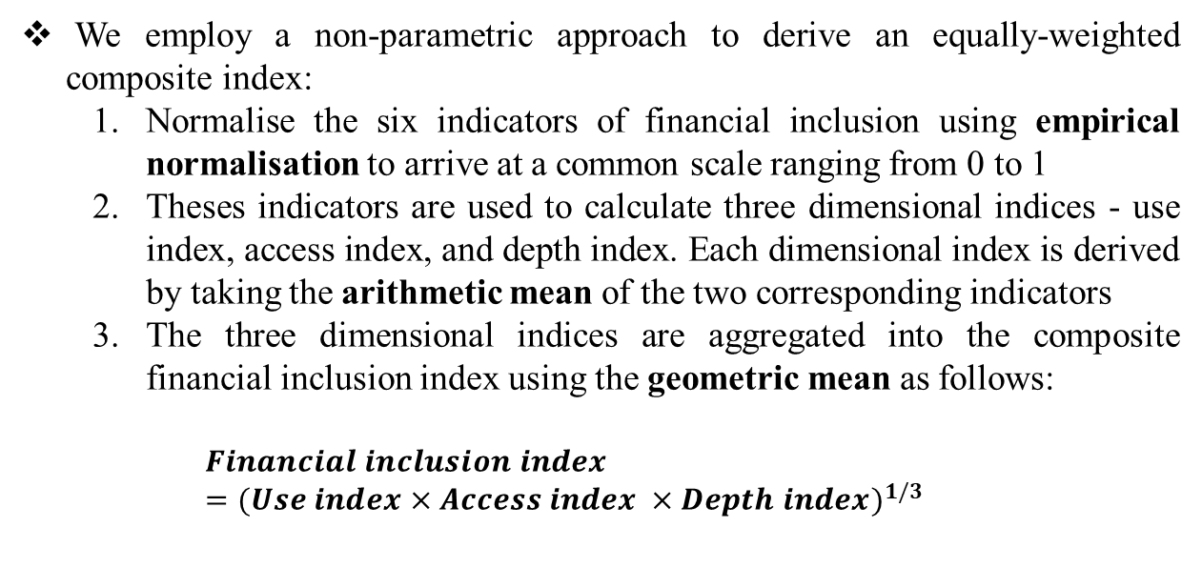
Methodology: Index Construction
We employ a non-parametric approach to derive an equally-weighted composite index:
  Normalise the six indicators of financial inclusion using empirical normalisation to arrive at a common scale ranging from 0 to 1
  Theses indicators are used to calculate three dimensional indices - use index, access index, and depth index. Each dimensional index is derived by taking the arithmetic mean of the two corresponding indicators
  The three dimensional indices are aggregated into the composite financial inclusion index using the geometric mean as follows:
  $$Financial inclusion index={(Use index×Access index ×Depth index)}^{1/3}$$

Slide 10
Index Results (1)
  The average score of our financial inclusion index shows that the most inclusive systems are developed countries that have high or upper-middle income. Spain, Japan, and Portugal score the highest average over the period
  While low income countries such as Congo and South Sudan have the lowest financial inclusion and India ranks 54th

Slide 11
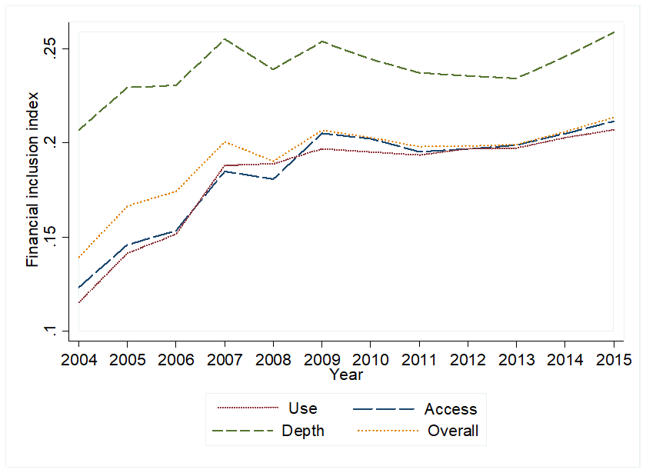
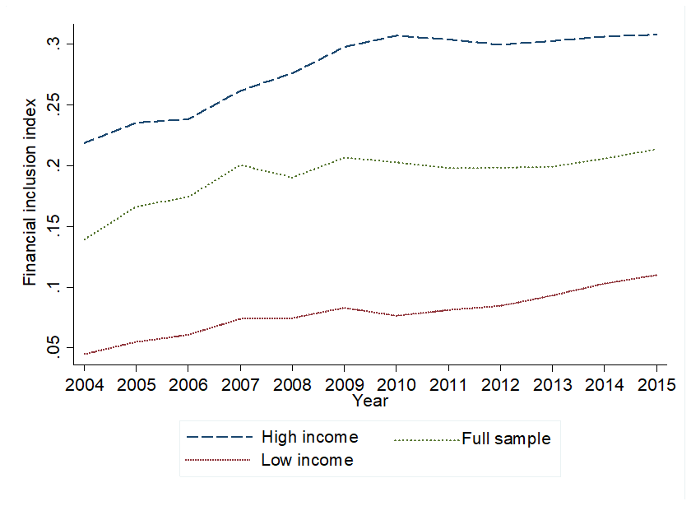
Index Results (2)
On average:
  There seems to be progress in financial inclusion over the sample period
  The progress appears most prominent in the use and access dimensions
  High and upper-middle income countries over-rank low and lower-middle income countries

Slide 12
Index Results (3)
On average:
  European countries over-rank other regions
  The Sub-Saharan African region ranks the lowest
  Sub-Saharan Africa and South Asia show improvement in financial inclusion over time

Slide 13
Financial inclusion and country-level characteristics
 | Model (1) | Model (2) | Model (3) | Model (4) | Model (5)
GDP per capita_{t-1} | 0.1168** | 0.0987**
 | (3.99) | (5.08)
Unemployment_{t-1} | -0.0005 | -0.0015** | -0.0033** | -0.0029** | -0.0033**
 | (-0.61) | (-2.07) | (-3.23) | (-2.64) | (-2.96)
Inflation_{t-1} | -0.0007** | -0.0009** | -0.0003 | -0.0004 | -0.0004
 | (-2.13) | (-2.86) | (-1.08) | (-1.24) | (-1.10)
Boone indicator₋₁ |  | -0.0583** | -0.0435** | -0.0433** | -0.0330**
 |  | (-3.24) | (-3.34) | (-2.92) | (-2.62)
Bank concentration_{t-1} |  | 0.0009** | 0.0012** | 0.0010** | 0.0009**
 |  | (2.16) | (2.35) | (2.09) | (2.08)
Capital regulation_{t-1} |  | 0.0025 | 0.0028 | 0.0031 | 0.0042**
 |  | (1.16) | (1.25) | (1.41) | (2.03)
Financial freedom_{t-1} |  | 0.0006 | 0.0008 | 0.0005 | 0.0012**
 |  | (1.26) | (1.56) | (0.97) | (2.37)
Government integrity_{t-1} |  |  | 0.0012**
 |  |  | (2.14)
HDI_{t-1} |  |  |  | 1.1572**
 |  |  |  | (3.92)
Individuals using internet_{t-1} |  |  |  |  | 0.0019**
 |  |  |  |  | (3.36)
Constant | -0.7453** | -0.6886** | 0.1096 | -0.6633** | 0.0797
 | (-2.91) | (-3.63) | (1.52) | (-2.92) | (1.39)
Country fixed effects | Yes | Yes | Yes | Yes | Yes
Time fixed effects | Yes | Yes | Yes | Yes | Yes
Clustering | Yes | Yes | Yes | Yes | Yes
Observations | 449 | 343 | 343 | 342 | 343
Adjusted R-squared (within) | 0.267 | 0.309 | 0.208 | 0.233 | 0.272
Greater banking system competition, concentration, bank capital regulation , and financial freedom are associated with higher financial inclusion
Higher levels of income, government integrity, human development, and internet usage are positively related to financial inclusion
While high unemployment and inflation are negatively associated with financial inclusion
Robust t-statistics in parentheses
*** p<0.01, ** p<0.05, * p<0.1

Slide 14
Other results
We re-construct the financial inclusion index using a two-stage principal component analysis (PCA) and re-estimate the baseline regressions with this index as the dependent variable
  Results largely confirm the baseline findings
We examine whether the association between financial inclusion and the country-level factors varies across countries with different income levels
  We find that bank competition and internet usage appear to be more important for enabling financial inclusion in low income countries
We conduct a number of robustness tests including:
  reconstructing the index setting the minimum and maximum values for our six financial inclusion indicators as the “natural zeros” and “aspirational targets”, respectively
  controlling for the potential impact of the financial crisis on financial inclusion by dropping the crisis years 2008-09 from our sample
    The results of the tests are largely consistent with our baseline findings

Slide 15
Sum up / Conclusions
Our results suggest considerable progress in financial inclusion over the period under investigation, most markedly in the use and access dimensions
Our findings indicate that financial inclusion is positively and significantly associated with GDP per capita, employment, bank competition, human development, government integrity, and internet usage
Our evidence also highlights the importance of considering the level of national income when designing policies to boost financial inclusion
Policy-makers worldwide should consider taking more action, particularly in countries with lower income, to improve the environment to stimulate bank competition and the use of technology in conjunction to achieve greater financial inclusion

Slide 16
Thank you!

Slide 17
Variables | Definition | Source
Financial inclusion
Financial inclusion index | An aggregate financial inclusion indicator at a country level based on three dimensions: use, access, and depth. It ranges from 0 to 1, with a higher value indicating greater financial inclusion. | Authors’ calculations
Use | Deposit accounts with commercial banks (per 1,000 adults). | FAS
 | Loan accounts with commercial banks (per 1,000 adults). | FAS
Access | Branches of commercial banks (per 100,000 adults). | FAS
 | ATMs (per 100,000 adults). | FAS
Depth | Bank deposits (% of GDP). | GFDD
 | Domestic credit to private sector by banks (% of GDP). | GFDD
Macroeconomic factors
GDP per capita | Gross domestic product divided by mid-year population (log). | WDI
Unemployment | Share of the total labour force that is without work but available for and seeking employment (%). | WDI
Inflation | Inflation measured as the annual growth rate of the GDP implicit deflator. The GDP implicit deflator is the ratio of GDP in current local currency to GDP in constant local currency. | WDI
Banking system conditions
Boone indicator | A measure of degree of competition based on profit-efficiency in the banking market. It is calculated as the elasticity of profits to marginal costs. A higher value of the Boone indicator implies a lower level of competition. | GFDD
Bank concentration | The degree of concentration of deposits in the 5 largest banks. | Bank Regulation Surveys (Barth et al., 2012)
Capital regulation | Sum of Overall Capital Stringency and Initial Capital Stringency. It ranges between 0-10, where a higher value indicates a higher level of capital stringency. | Bank Regulation Surveys (Barth et al., 2012)
Financial freedom | An indicator of banking efficiency as well as a measure of independence from government control and interference in the financial sector. It ranges between 0-100, where a higher value indicates a higher level of financial freedom. | Heritage

Slide 18
Institutional environment
Government integrity | Derived by averaging scores for the following factors, all of which are weighted equally: public trust in politicians, irregular payments and bribes, transparency of government policymaking, absence of corruption, perceptions of corruption, and governmental and civil service transparency. It ranges between 0-100, where a higher value indicates a higher level of government integrity. | Heritage
Socioeconomic factors
HDI (Human development index) | Summary measure of average achievement in key dimensions of human development: health, education, and standard of living. It ranges between 0-1, where a higher value indicates a higher level of human development. | UN human developments reports
Technological factors
Individuals using internet | Internet users are individuals who have used the internet (from any location) in the last 3 months (% of population). The internet can be used via a computer, mobile phone, personal digital assistant, games machine, digital TV, etc. | WDI
Note: The table defines the variables used in the analysis and data sources.

Slide 19
Panel A: Full sample
Variable | Obs | Mean | Std. Dev. | Min | Max
Deposit accounts with commercial banks (per 1,000 adults) | 779 | 1092.14 | 1148.59 | 13.23 | 7211.21
Loan accounts with commercial banks (per 1,000 adults) | 779 | 293.77 | 295.57 | 1.30 | 1275.83
Branches of commercial banks (per 100,000 adults) | 779 | 16.77 | 17.81 | 0.61 | 99.24
ATMs (per 100,000 adults) | 779 | 34.65 | 35.05 | 0.05 | 157.36
Bank deposits (% of GDP) | 779 | 49.82 | 38.83 | 5.07 | 217.53
Domestic credit to private sector by banks (% of GDP) | 779 | 44.54 | 33.40 | 2.63 | 156.12
Financial inclusion index | 773 | 0.20 | 0.16 | 0.00 | 0.68
GDP per capita | 779 | 8.24 | 1.30 | 5.45 | 10.81
Unemployment | 508 | 9.49 | 7.09 | 0.50 | 32.20
Inflation | 779 | 5.45 | 6.15 | -15.71 | 29.05
Boone indicator | 688 | -0.06 | 0.11 | -0.65 | 0.24
Bank concentration | 524 | 74.24 | 19.05 | 37.01 | 100.00
Capital regulation | 583 | 6.64 | 2.11 | 1.00 | 10.00
Financial freedom | 721 | 50.79 | 15.66 | 20.00 | 90.00
Government integrity | 727 | 36.67 | 16.01 | 10.00 | 87.00
HDI | 771 | 0.66 | 0.14 | 0.34 | 0.91
Individuals using internet | 770 | 29.54 | 24.22 | 0.51 | 89.63
Panel B: Income groups
 | High income group |  | Low income group |  | Difference in means (%)
 | Obs | Mean | Obs | Mean
Deposit accounts with commercial banks (per 1,000 adults) | 425 | 1629.66 | 354 | 446.82 | 256***
Loan accounts with commercial banks (per 1,000 adults) | 425 | 455.55 | 354 | 99.56 | 358***
Branches of commercial banks (per 100,000 adults) | 425 | 23.69 | 354 | 8.46 | 180***
ATMs (per 100,000 adults) | 425 | 53.94 | 354 | 11.49 | 370***
Bank deposits (% of GDP) | 425 | 63.95 | 354 | 32.86 | 95***
Domestic credit to private sector by banks (% of GDP) | 425 | 60.44 | 354 | 25.46 | 137***
Financial inclusion index | 425 | 0.29 | 348 | 0.09 | 239***
Note: The table reports descriptive statistics Panel A reports summary statistics for variables used in the analysis for the full sample of 95 countries over the period 2004-15. Panel B reports the comparison of financial inclusion variables between the sub-samples of high (and upper middle) income and low (and lower middle) income countries, with the t-test for the equality of means reported in the last column. *, **, *** indicate significance at 10 percent, 5 percent, and 1 percent levels, respectively. Definitions of the variables are provided in Appendix B.

Slide 20
Indices | Indicators | Normalised weights
Use | Deposit accounts with commercial banks (per 1,000 adults) | 0.633
 | Loan accounts with commercial banks (per 1,000 adults) | 0.367
Access | Branches of commercial banks (per 100,000 adults) | 0.591
 | ATMs (per 100,000 adults) | 0.409
Depth | Bank deposits (% of GDP) | 0.574
 | Domestic credit to private sector by banks (% of GDP) | 0.426
Aggregate | Use | 0.298
 | Access | 0.293
 | Depth | 0.408
Note: The table reports the weights of (i) financial inclusion indicators in the respective dimensional indices and (ii) dimensional indices in the aggregate financial inclusion index, both obtained from principal component analysis. Definitions of the variables are provided in Appendix B.

