Slide 1

Financial Inclusion, At What Cost? : Quantification of Economic Viability of A Supply Side Roll Out Oct 2020:Published European Journal of Finance
6 November 2020
Mainstreaming Financial Inclusion Workshop, EBS, University of Essex
Sheri Markose, Thankom Arun and Peterson Kitakogelu (University of Essex )

Slide 2
Rationale : Financial Development, Financial Inclusion, GDP Growth and Reduction of Income Inequality
Extensive and longstanding discussion on financial development and economic growth (Levine 1997). Access to finance is seen to enable people to transform their production, employment activities and to exit poverty. (Aghion and Bolton, 1997, Banerjee and Newman, 1993, Banerjee, 2001)
Financial Inclusion : Objective pursued by successive govts and private sector orgs in India; 2014 PMJDY initiatives of Modi govt acknowledged by many to have finally and substantially moved the dial on the number of registered bank account holders.
World Bank’s Global Findex database, 80 percent of adults in India have a financial account now, up from 53 % in 2014 and 35% in 2011
Supply side : We investigate specific incentives and outlays that had a clear rural bias on the part of encouraging public sector banks
However, we find the Public Sector Banks suffer an economic shortfall due to insufficient PMJDY bank balances

Slide 3
Roadmap I: Double Bind Problem Faced by providers of banking services for poor
Focus on supply side funding gaps inherent to financial inclusion schemes threaten their efficacy/sustainability
Banks struggle to achieve economies of scale to drive down average fixed financial infrastructure costs, while average account balances are low due to insufficient income of Below Poverty Line (BPL)customers
As FI bank account expansion occurs, the size of deposits fall faster than the cost per account
Service for the poor becomes poor service due to insufficient economic returns (Das (2017) and Sriram (2011))
Model applicable to any FI drive; Specific application of model to PMJDY FI Drive

Slide 4
Roadmap 2: Model
A new Average Cost Bank Infrastructure Model for economies scale vs PMJDY Bank Account Balances
(Beck, T., and de la Torre, A. (2006); Humphrey, D. (1990) )
Innovative approach: based on cross sectional bank level data from 2014 till 2017 used to quantify the incentives and costs involved in targeting unbanked households.
We give a monetary estimate of economic shortfalls or surpluses for participating banks, measured as bank balances relative to outlay costs and subsidies per PMJDY beneficiary.

Slide 5
Roadmap 3 : Lack of Economic Viability of FI Could exacerbate Systemic Risks ;Results & Role of Tech As Solution
Lack of economic viability of PMJDY accounts found in majority of Indian public sector banks, a matter which is problematic in view of their extant financial fragility.
Majority, 17 of the 26, public sector banks suffer estimated shortfalls in terms of insufficient bank balance per PMJDY account relative to the estimated average net costs.
8 out of the 11 public sector banks been under the Prompt and Corrective Action of the Reserve Bank since 2017, viz.Allahabad Bank, Dena Bank, Bank of India, Central Bank of India, IDBI Bank, Indian Overseas Bank, UCO Bank, and Union Bank of India (see, Misra and Tankha, 2018)
Problem of credit for subprime customers: could result in financial instability or exacerbate the burden on weak institutions (Collard and Kempson (2005), Rajan (2010) and Khan (2012)).
Raghuram Rajan , Governor of the Reserve Bank of India in 2014, highlighted this problem of burdening public sector banks with the costs of the PMJDY program (see, Mishra and Tanka, 2018 ).
Economic non-viability remedied by the PMJDY tie up with Technology of E-Aadhar Biometric based Bank Accord Card Government – Persons
We estimate: How long it will take for the non-economic viability to be overcome
About 4 years

Slide 6
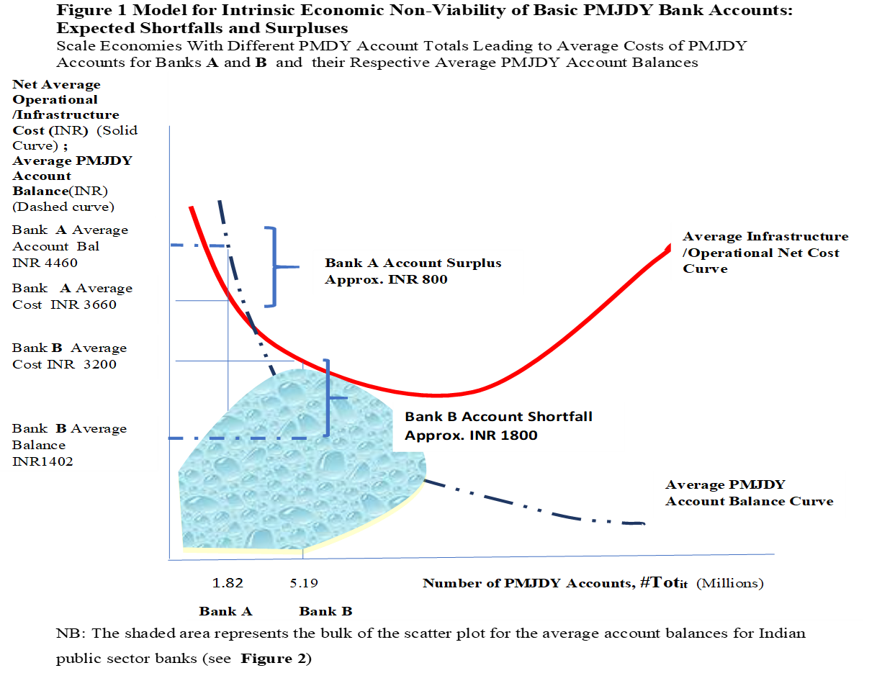
Figure 1 Model for Intrinsic Economic Non-Viability of Basic PMJDY Bank Accounts: Expected Shortfalls and Surpluses Scale Economies With Different PMDY Account Totals Leading to Average Costs of PMJDY Accounts for Banks A and B and their Respective Average PMJDY Account Balances

Slide 7
Figure 2 Public Sector Banks' Average PMJDY Account Balance (INR, Vertical Axis) vs Total Number of PMJDY Accounts (Millions, Horizontal Axis) 2014

Slide 8
Figure 3 Public Sector Banks' Average PMJDY Account Balance (INR) vs Total Number of PMJDY Accounts (Millions): 2015 Square Series 2;2016 Diamond Series 1 have to move upwards if bank accounts have to be viable

Slide 9
Supply Side Incentives and Costs Models and Panel Regression Results Cross Section of all PMJDY Banks for 2014-2017
For each bank the following time series are constructed : AZ Per PMJDY beneficiary balance ; BB : per PMJDY beneficiary rural account subsidy (0.01 of rural PMJDY balances) ; BC is per PMJDY beneficiary cost for bank mitra (@Rs 3000) ; BD is per PMJDY beneficiary cost of opening urban account (@ Rs 120) ; BE per PMJDY beneficiary cost of rupay card (@ Rs 140)
Clearly these unit costs differ from bank to bank depending on how much effort is directed for example to bank mitras or urban accounts etc

Slide 10
Economic Effectiveness for Banks
Per capita PMJDY bank balances for each bank relates to the costs and subsidies in the PMJDY FI drive. This yields a measure of the estimated shortfall ( negative ) and gains that PMJDY has had on bank economic viability
There is evidence that urban accounts with larger balances have a positive impact on the capacity of banks to push forward rural FI

Slide 11
Panel Regression of Per Capita PMJDY Bank Balance :Shortfall Relative to Per Capita Subsidies (Rural subsidy)and Costs (Mitra, Urban Bank Account, Rupay Card) Note Coeffs all significant for public sector banks

Slide 12
Cross Sectional Per Capita PMJDY Net Bank Balance Shortfalls for Public Sector : Net of Estimated Costs From Panel Regression Approx Rs 2778 shortfall
Majority of Public Sector Banks with Banks with Estimated Per PMJDY Beneficiary Negative Net Bank Balances (Shortfalls) 16 banks
8 Public Sector Banks with Estimated Per PMJDY Beneficiary Positive Net Bank Balances , in 2016/17

Slide 13
Rural and Regional Banks Rs636 Shortfall ( Canara Bank in black)
Private Sector Banks Shortfall (HFDC in Black ; ICICI in red/not engaged) Rs163.75

Slide 14
Table 5: Estimated Total Shortfall in PMJDY Accounts of Public Sector Banks (INR)
 | 2014 | 2015 | 2016 | 2017
Average Estimated Per PMJDY Account Shortfall for Public Sector Banks (INR) | 3374.25 | 2670.9 | 1603 | 1525.47
Average number of PMJDY Accounts per bank (mn)(See Appendix 3) | 3.24 | 6.10 | 8.24 | 10.21
Estimated Total Shortfalls ( INR mn) | 10,932.57 | 16,292.49 | 13,208.72 | 15,575.04

Slide 15
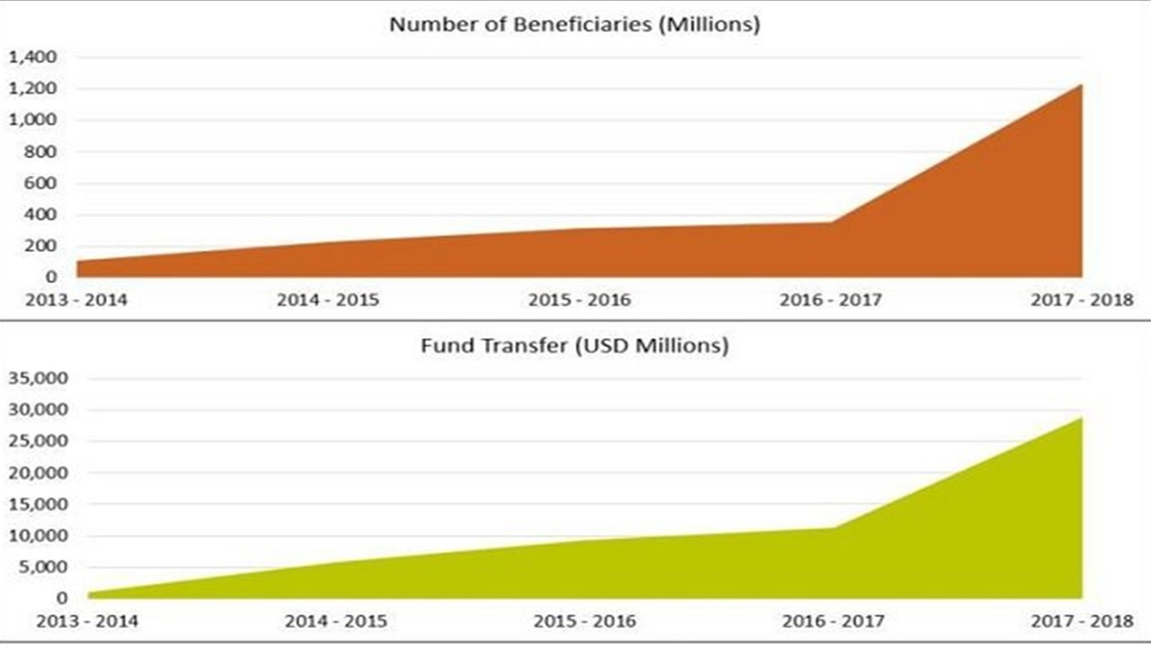
Number of E-Direct Benefit Transfer Govt-Person Beneficiaries and DBT Value: Long Term Viability of Indian Financial Inclusion Depends on This

Slide 16
Create an Index Expected Shortfall (IES) and FI Target (Tar)
We run a panel regression with fixed effects for the public sector banks for 2014-2017 with the following specification
I(ES) = Constant + bI(Tar)+ e.
The bold font indicates the vector notation for the panel data.
I(Tar) | -0.250** (-2.63) | 0.0103

Slide 17
Conclusion- Financial Inclusion: Work In Progress Aadhar Links for E- Govt- Person Payments
The estimated per bank average shortfall is found to be around INR1525 for 2017. This implies at least a 4 year period before public sector banks move into PMJDY account surplus.
Productive Credit Function : Example 98% FI in Kerala , yet no change in using bank credit by poor who continue to use informal forms of debt (Rudra Sensarma 2017 field study of 600 rural Keralites)
A pilot program in Jharkand that looked at the direct transfer of funds to villagers’ bank accounts showed some people had to spend as much as 96 hours withdrawing money and purchasing rice from government ration shops!.
India’s banking system “lags in terms of physical infrastructure and has failed to reach the poor,” (EY and the Associated Chambers of Commerce and Industry of India, 2017), particularly in expanding ATMs and bank branches.
Problem of credit for subprime customers, could result in financial instability or exacerbate the burden on weak institutions (Collard and Kempson (2005), Rajan (2010) and Khan (2012)).

Slide 18
Account Use On Left Before Green Those with Accounts 48% in 2017 claim no use ; Green Are those with no Accounts 54% claim insufficient funds : Source Global Findex, India

Slide 19
Note fundamental demand side push for openings accounts. Global Findex India (lower middle income) Govt payment Recipients 57% claim in 2017 (29% in 2011) that they opened first account to receive these payments ; In 2017 59% say they received Govt payments in accounts vs 20% in cash only

