Slide 1

Economics Department
Overview of Computational Microeconomics and Complexity Economics:
New Directions In Agent-Based Computational Economics (ACE) and Complexity Economics
Sheri Markose (Economics Dept. University of Essex) scher@essex.ac.uk
Simulation links of software Sheri Markose co-developed with Amadeo Alentorn
http://www.gemasainz.com/amadeo/index.html

Slide 2
ICT and Agent-based Computational Economics (ACE) to Augment Statistics and Econometrics For Economic Analysis and Inference
In an era of ICT (Information and Communication Technologies) and www based on programming virtual realities using agent based models: this is soon becoming a routine method of inference and knowledge acquisition- Economists need new skills in this field
ESRC (Economic and Social Research Council)Conference at University of Essex on Diversity in Macroeconomics responded to failure of extant macro-economic models in the context of the 2007 Great Financial Crisis: the aim is to build capacity within UK Econ. Depts. in ACE and Complexity Economics.
Experimental and Behavioural Economics to Investigate Actual Human Behaviour Rather than Assume Rationality.

Slide 3

Early 2000s BBC Programme : Time Commanders Artificial Simulation of Historical Battles With Humans Interacting On One Side – The Future of Policy Design: Essex Vice Chancellor Ivor Crewe: “This cannot fail” and a new centre was born in 2002

Slide 4
Road Map of Talk
Where has ACE come from ? Santa Fe Institute and then in UK Essex Centre pioneering role
What are its foundations ?
What sort of applications has ACE resulted in
ACE models at Essex Econ Dept: Macro economics and Micro-economics
The Artificial Stock Market model and Herding;
Cap and Trade -Design of Smart Market for Traffic Congestion : Foresight Project
(Global Macronet : Cross Border Imbalances and Within Country Imbalances- Macro application)
Central Clearing Platforms
Complexity Economics Relating to Novelty, Innovations and Structure Changing Dynamics
Concluding remarks

Slide 5
AGENT BASED COMPUTATIONAL ECONOMICS (ACE) : A NEW,EXCITING SUB-FIELD OF ECONOMICS
THIS IS BASED ON THE NEW AGE WORLD OF ARTIFICIAL ENVIRONMENTS WITHIN COMPUTERS
ENTIRE SYSTEMS CAN BE RECREATED AND CAN THEN DYNAMICALLY EVOLVE AND GROW : SOMETIMES CALLED ARTIFICIAL LIFE
THESE ENVIRONMENTS MAY HAVE PURELY ARITIFICIAL AGENTS AND/OR CAN HAVE INTERFACES WITH HUMANS
EXAMPLES OF THIS AT A HIGH LEVEL OF SOPHISTICATION ARE COMPUTER GAMES
E-bay and use of ‘BOTs’ in Search Engines for lowest price
THIS NEW TECHNOLOGY IS INCREASINGLY BEING ADOPTED FOR ECONOMIC MODELLING, MARKET AND POLICY DESIGN

Slide 6
The ACE Revolution:Foundations
Interdisciplinary Edifice of Complexity Studies: Physics,Biology and Evolution,Population,Society and Markets
Advances in Maths of Computation: Godel-Turing-Post
Advances in Computer Hardware and Software leading to artificial worlds

Slide 7
Application of ACE
I.Markets As Complex Adaptive
Systems (CAS)
Absence of Command and
Control vs. Self Organization
•Dynamics from large
Numbers of interacting agents
•Examples:Innovation;Cities and transport
Social and Economic Networks,Stock market phenomena
II:Market Design
Examples Trading Platform,
Cap and Trade Systems
Pollution Markets
Congestion Markets
Computational Testbedding and wind tunnel tests
Combine with human experiments
**Experiments in real time
III.Policy Design
Not Equation driven hence
avoids Lucas Critique of Econometric models
#Check out unintended consequences of bad policy with perverse incentives
**Experiments
In real time

Slide 8
Who or what are Agents in ACE Simulations?
Agents are computer programs with varying degrees of autonomy and/or computational intelligence
Agents can have fixed simple decision rules or have full powers of adaptive algorithms with capacity of self-referential calculation; evolutionary learning like Erev-Roth Reinforcement Learning; Genetic Algorithms
In traditional economics agents are assumed to have full rationality and that efficiency of the system as whole is meant to reflect this. This could be a mistaken view
Structures/Topology, Data driven meaning nodes characterized by micro data from census reports, balance sheets etc , Holistic Data Visualization: Model Verite

Slide 9
Agent based vs. Analytical models
Analytical models make simplifying assumptions: The representative agent ; equal size banks with equal size payments
Agent based models can process and run data in real time and can simulate a system in “model vérité” to replicate its structural features and perform “wind tunnel” tests. Eg. Of Interbank large value payments Simulator : ¼ of a country’s GNP goes through the system daily.
Nirvana of Agent based Computational Economics (ACE)
  Have agents respond autonomously and strategically to policy changes

Slide 10
What is computational/electronic market micro-structure ?
Alibaba, E-bay
Design of e-markets
Price Determination
Winner Determination
How to Access Electronic Markets ?
Algorithms needed

Slide 11
Example of An Agent Based Economic Model: Canonical Example of Self-Reflexive Systems and Archetype of the Contrarian (called Liar in Math Logic)
First example developed by Santa Fe Institute is the Artificial Stock Market (ASM)
Brian Arthur gave a powerful rebuttal of why traditional economic analysis will fail to understand stock markets and why ACE modelling is needed
In a stock market an investor makes money if he/she can sell when everybody else is buying and buy when everybody else is selling. In other words, one needs to be in the minority or contrarian
Arthur called this the El Farol Bar problem. You want to go to the pub when it is not crowded. Assume everybody else wants to do the same. How can you rationally decide/strategize to succeed in this objective of being in the minority ?
If all of us have the same forecasting model to work out how many people will turn up – say our model says it will be 80% full – then as all of us do not want to be there when it is crowded – none of us will go.
This contradicts the prediction of our model and in fact we should go. If all reasoned this way – once again we will fail etc. So there is no Homogenous Rational Expectations and no rational way in which we can decide to go. Traditional economics cannot deal with this
Hence, Brian Arthur said we must use ACE models and see how the system dynamically self-organizes

Slide 12

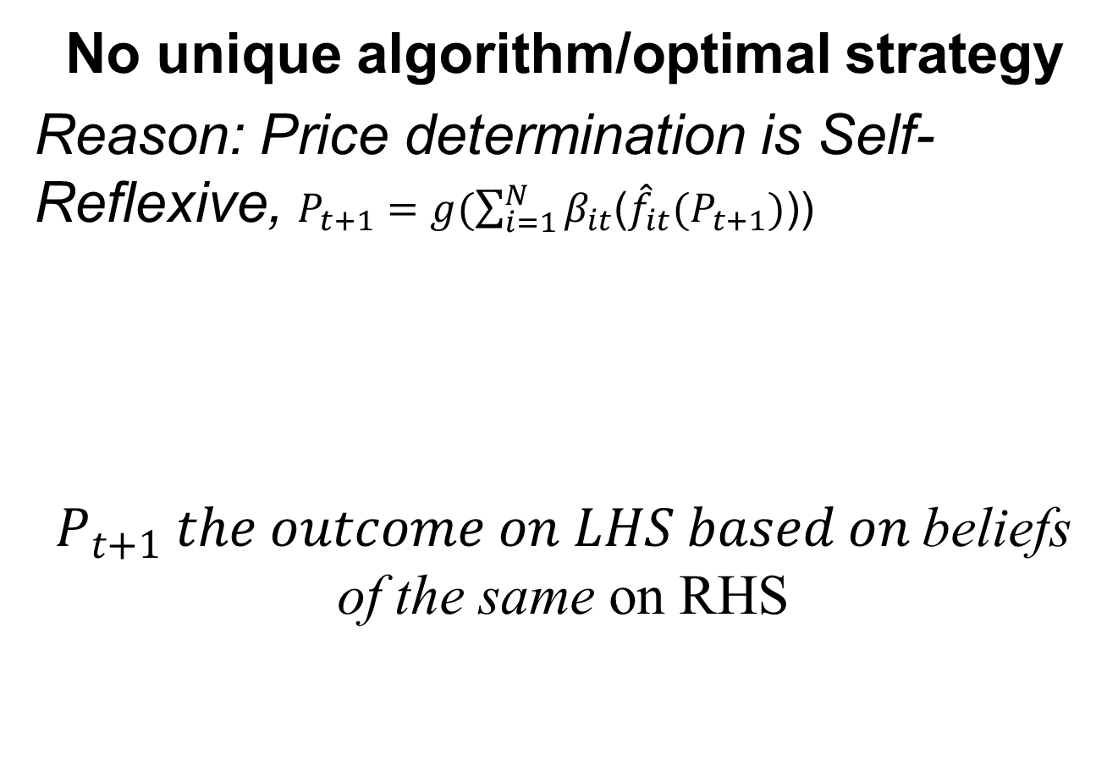
Winning a stock game a non-computable game : There are winning strategies but no algorithm for this
No unique algorithm/optimal strategy
Reason: Price determination is Self-Reflexive, $P_{t+1}=g(\sum_{i=1}^{N}{β_{it}}$(${\hat{f}}_{it}(P_{t+1})$))
$P_{t+1} the outcome on LHS based on$beliefs of the same on RHS
Strategies based on beliefs of future price
Modifying beliefs
$$g\left(∙\right) is the price determination function$$
$$β_{it} is the strategy of individual agent at time t$$
$${\hat{f}}_{it} is the belief of individual agent at time t$$

Slide 13
Simple Stock Market Model With
Agents Relying on Investment ‘Tips’ From Others/Gurus
http://privatewww.essex.ac.uk/~aalent/herding/herding.htm
Agents have to buy or sell one unit of an asset; they take advise from their neighbours; they act on the basis of the majority view amongst their neighbours;
Neighbours who give bad advise are eventually cut off and new advisers are found
All agents are identical except for how far back they can remember;
Some have zero memory and they give random advise; others with memory give the average trend of the market
Who will give best advise in a minority winning structure ?
Eventually what does the communication network look like?
Hence, paper is called Dynamic Learning, Herding and Guru Effects

Slide 14
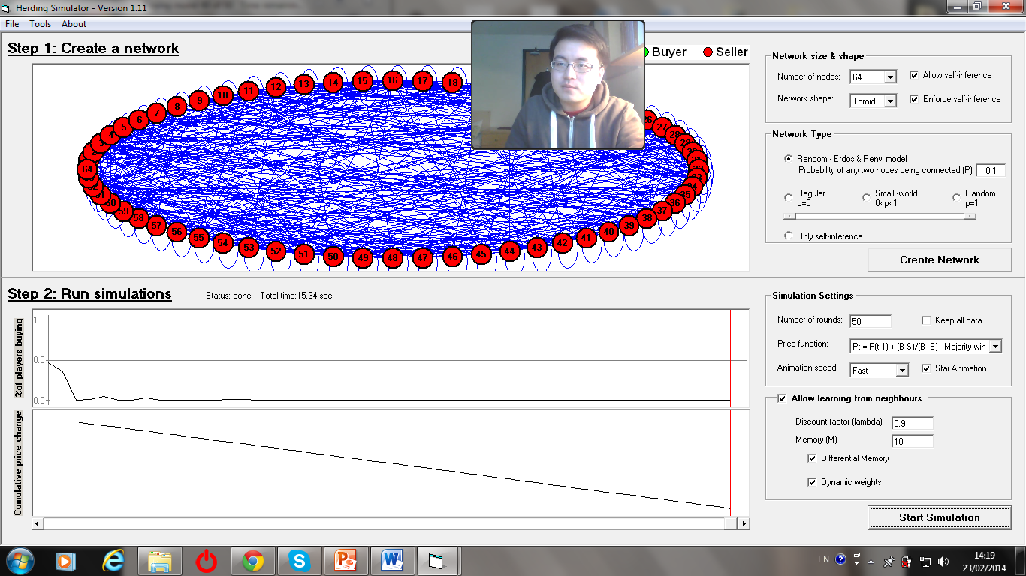
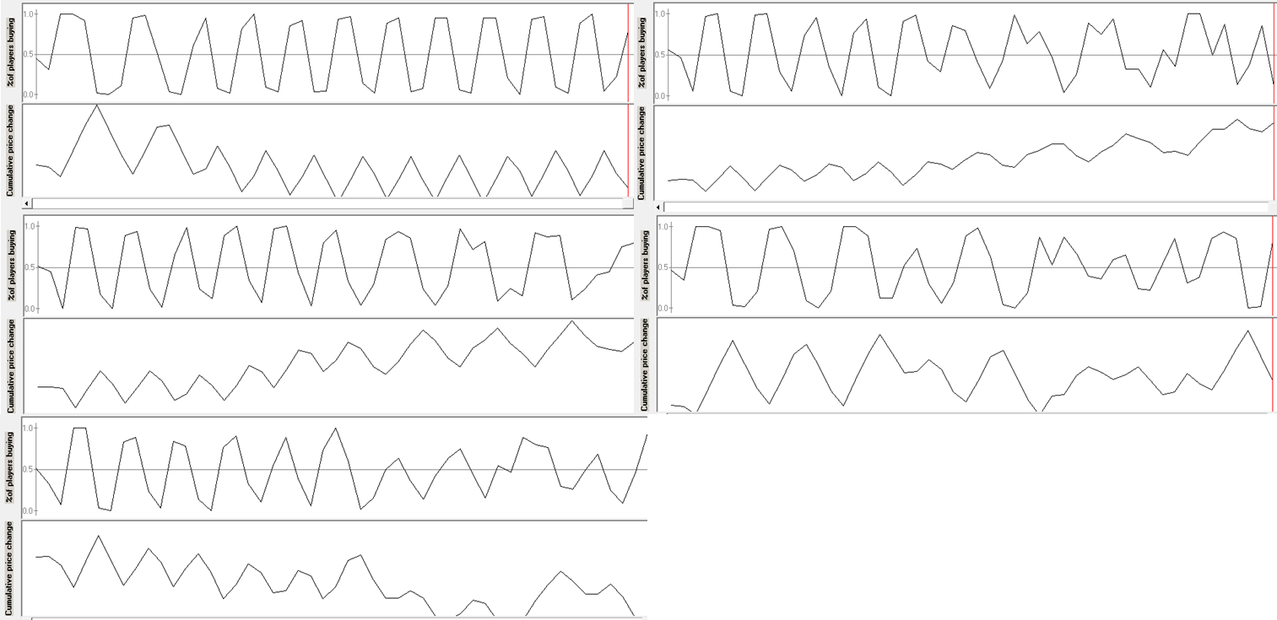
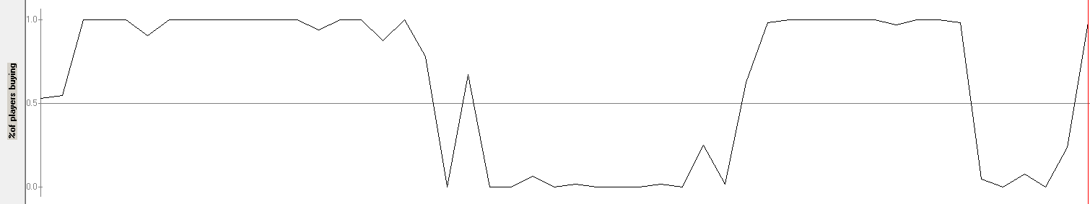
Price trend With Different Determination Rules
MAJ O R
I
T
Y
When majority wins, the price is increasing or decreasing. In this case is decreasing since everyone is buying.
M
I
N
O
R
I
T
Y
When minority wins, we experience boom and bust in price.
R
A
N
D
O
M
The price is fluctuating but not is a stable rate as in the minority case.

Slide 15
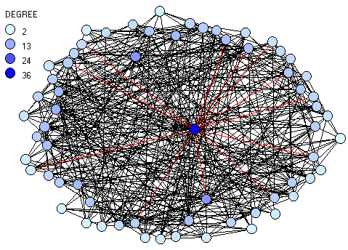
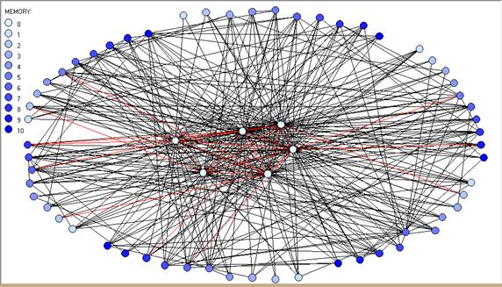
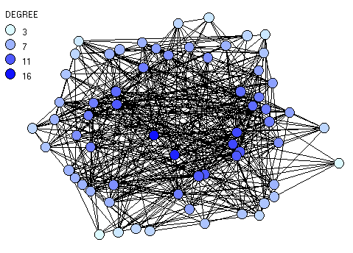
Degree of memory and structure of Communication Network
MAJORITY WINS:
GURU IN THE CENTER OF NETWORK HAVE HIGHEST MEMORY
2) MINORITY WINS:
GURU IN THE CENTER OF NETWORK HAVE ZERO MEMORY
3) RANDOM WINS:
NO STRUCTURE

Slide 16
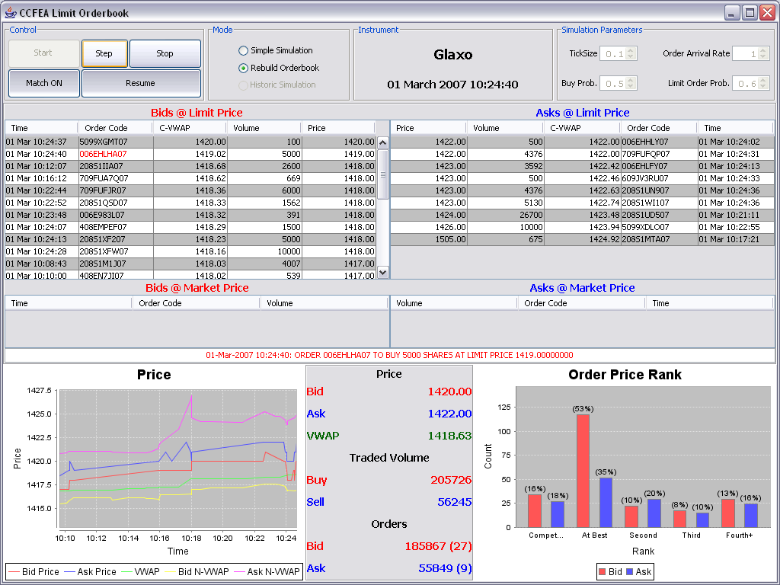

Slide 17

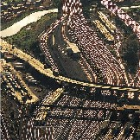



Future Intelligent Infrastructure
2007 Project funded by
UK Office of Science and Technology
Intelligent Charging: Smart Market
Protocols for Road Transport
Sheri M. Markose Amadeo Alentorn and Deddy Koesrindartoto
Economics Department and Centre For Computational Finance and Economic Agents (CCFEA), University of Essex,
Phil Blythe, Sergio Grosso, Anett Ehlert and Dilum Dissanayake
Transport Operations Research Group (TORG), University of Newcastle upon Tyne
And
Peter Allen
Complex Systems Management Centre, Cranfield School of Management

Slide 18
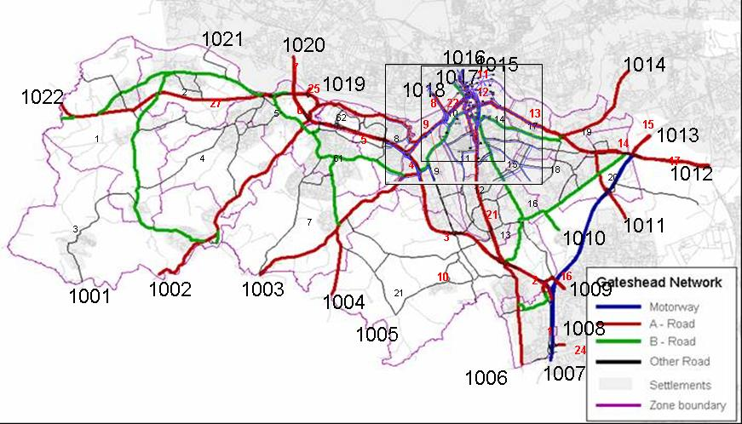
The actual Central Gateshead Model:

Slide 19
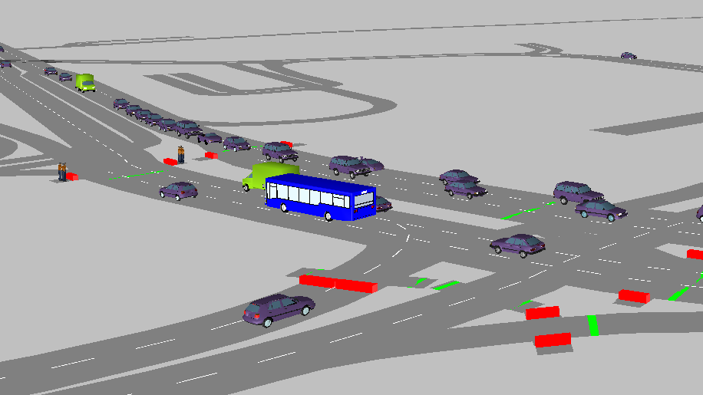

Slide 20
How Cap & Trade Works
Emission Cap
  Limits emissions and maintains reductions
  Provides market value and certainty
  Allows trading without government approval
Trading
  Minimizes costs through compliance flexibility
  Creates incentives to reduce costs going forward
Limited Supply of
allowances (cap)
Demand for
allowances
Economic value
for allowances
Economic incentives
to reduce emissions

Slide 21
Purpose: How to change travel behaviour, fewer journeys
Smart Markets could bring intelligence into the road transport network to address congestion; planning of green infrastructure can be done with digitally based agent based models of city centres
A Smart Market is an on-line auction:
  Potential users submit bids
  Auction determines the price and ‘winners’
  Infrastructure operators pre-set the limits (slots)
  We explore a road pricing regime which fixes (Cap) the number of vehicles able to use the roads at peak time

Slide 22
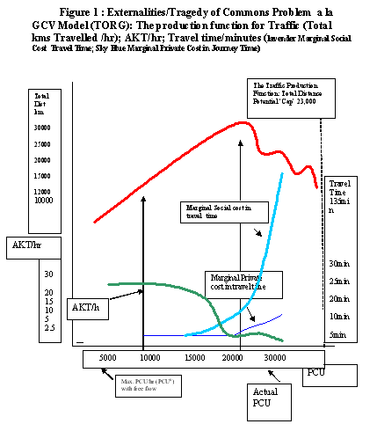

Slide 24
The socio-economic status of commuters
We also know the income distributions for different classes of
Professionals for the North East:
This enables us to calculate the sensitivity to
Road User Charges from the different commuters

Slide 25
The income distribution of 16740 car drivers traversing Gateshead cordon area (i.e. commuters with income greater than £10,500) (Mean annual income is £ 21990.39)

Slide 28
Current demand
20% reduction in travel slots
30% reduction in travel slots
10% reduction in travel slots

Slide 29
CCPS AND OTC DERIVATIVES REFORM: Network Analysis
ECMI CONFERENCE
Navigating the storm:
Setting long-term goals in volatile market conditions
2015 Annual Conference ∙ October 20th ∙ Brussels, National Bank of Belgium
Professor Sheri Markose (Essex University)
Analyses based on 41 G-SIBs used in 2013 MAGD(Macroeconomic Assessment Group on Derivatives) Report for BCBS/FSB http://www.bis.org/publ/othp20.pdf
Co-authors Mark Manning, Alexandra Heath, Gerard Kelly (Reserve Bank of Australia) and Ali Rais Shaghaghi
Network Graphics Done by Ali Rais Shaghaghi

Slide 30
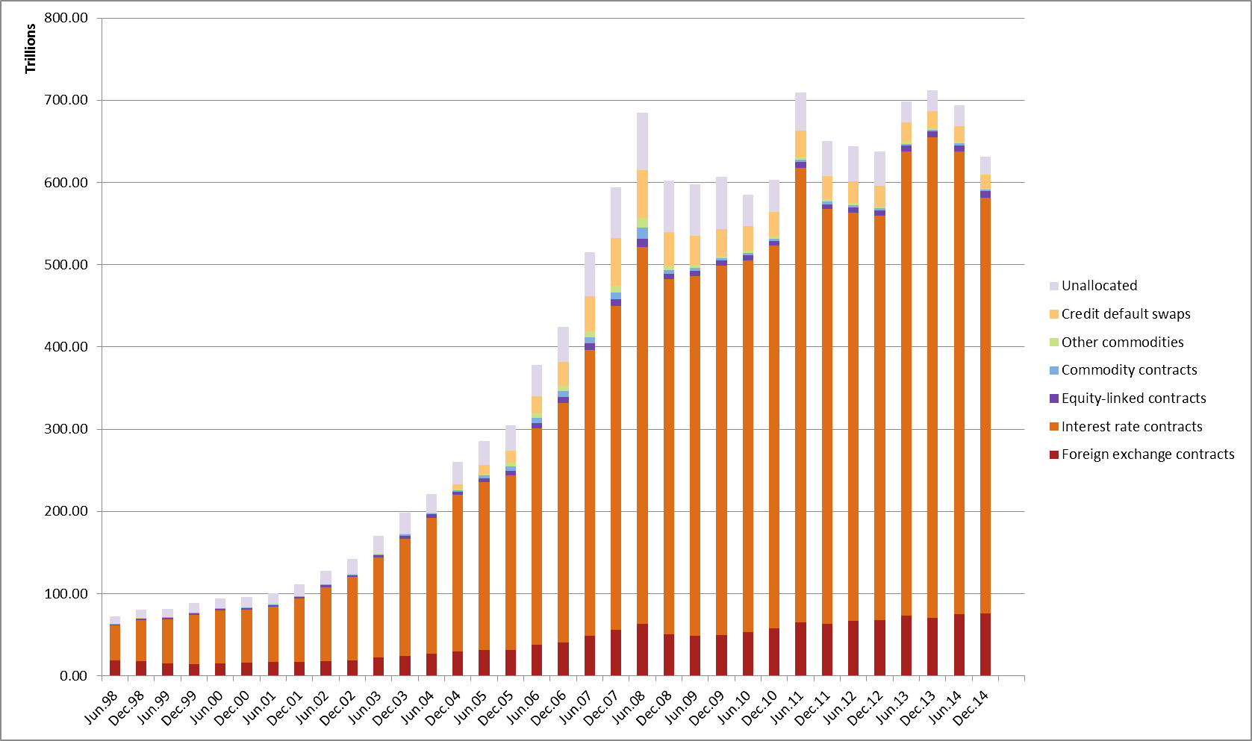
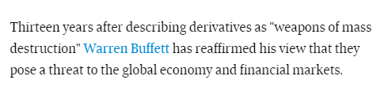
Motivation: For OTC Derivatives Reforms
How Do We Assess G20/EMIR OTC Reforms for Efficacy and System Stability?
$600+ Trillion OTC Derivatives
G20’s ambitious program to Improve market infrastructure following the 2007-2008 crisis, CCPs)to help mitigate systemic risk.
  Strengthen risk management; reduce interconnectedness
  However: concentrate risk in one or a few nodes in the financial network and also increase institutions’ demand for high-quality assets to meet collateral requirements resulting in funding and liquidity risk
Source:
BIS Derivatives Statistics

Slide 31
The European Union regulation on derivatives, central counterparties and trade repositories (EMIR)
Principles for Financial Market Infrastructures (PFMIs) (CPSS-IOSCO 2012)
Trading obligations of standardized OTC derivatives on exchanges
Clearing obligation for eligible OTC derivatives through central counterparties
Reduce counterparty credit risk and operational risk for bilaterally cleared OTC derivatives: Collateral Rules
Reporting obligation for OTC derivatives to Trade Repositories
Non-centrally cleared contracts subject to higher capital requirements
Common rules for central counterparties (CCPs) and for trade repositories
Rules on the establishment of interoperability between CCPs
Ensure continuity of critical CCP services under extreme market conditions that could threaten CCP viability : So Called Cover 2 Default Fund Contributions
To deal with such scenarios, the PFMIs require CCPs establish recovery and resolution plans (FSB 2013; CPMI-IOSCO 2014)

Slide 32
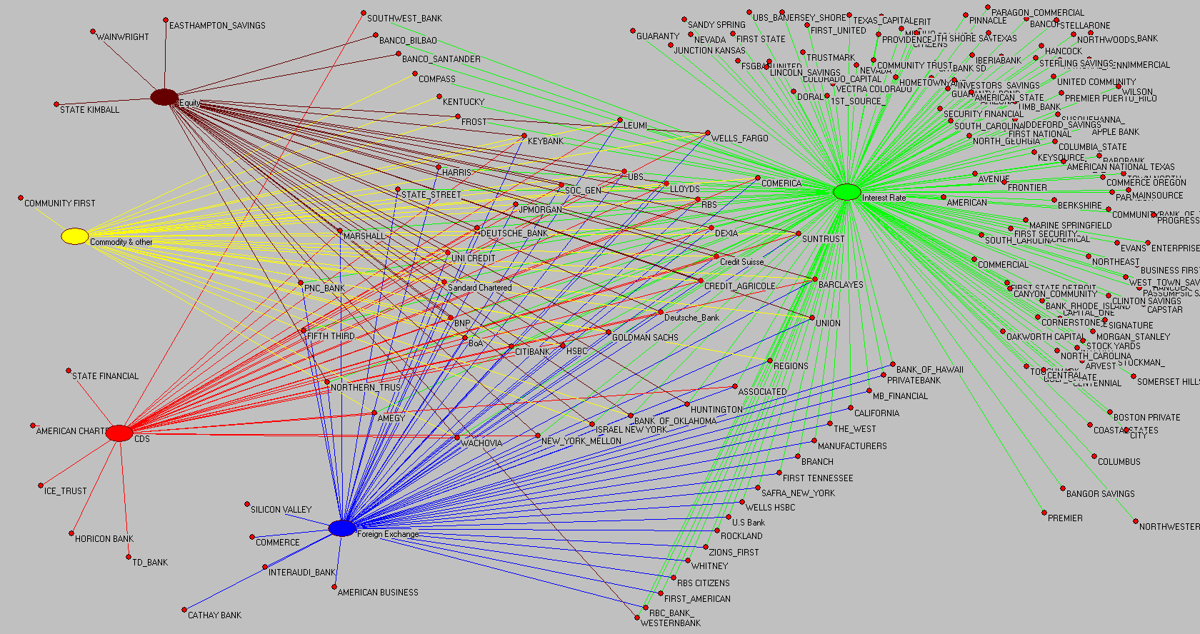
Structure of Global Financial Derivatives Market (2009,Q4 202 participants): Green(Interest Rate), Blue (Forex), Maroon ( Equity); Red (CDS); Yellow (Commodity); Circle in centre Broker Dealers in all markets
Source Markose (2012) IMF WP

Slide 33
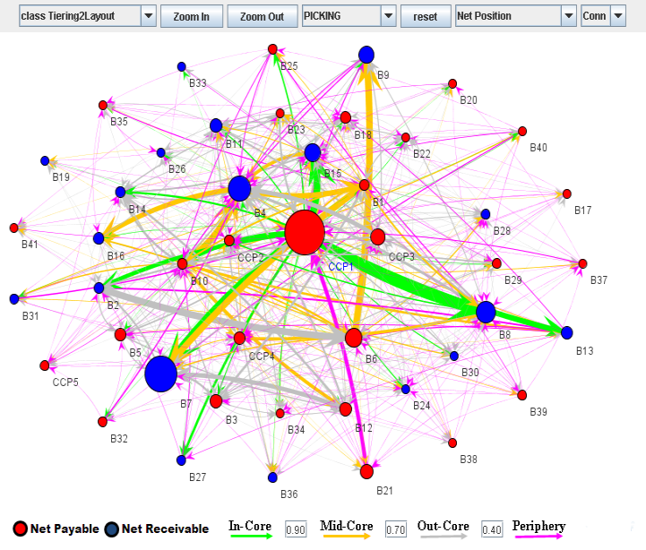
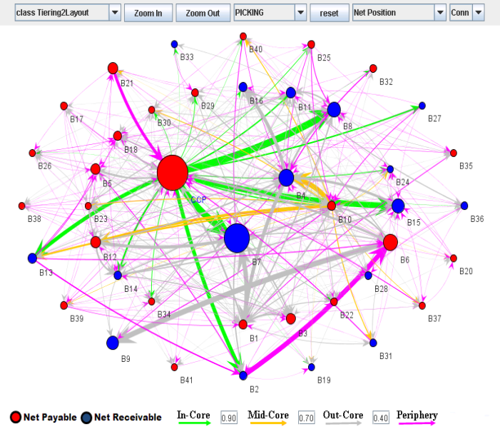
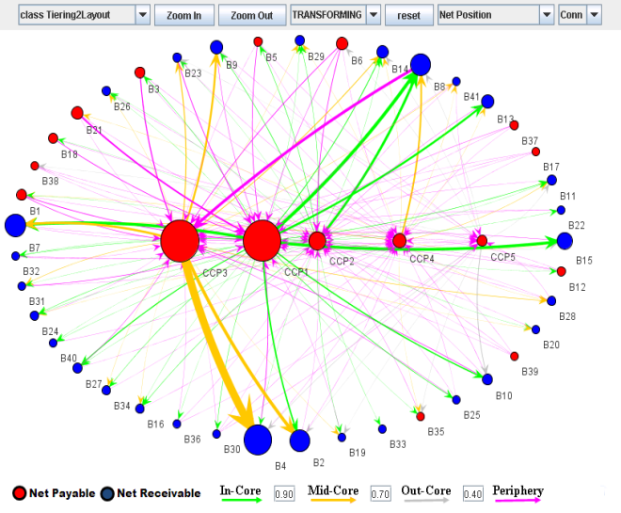
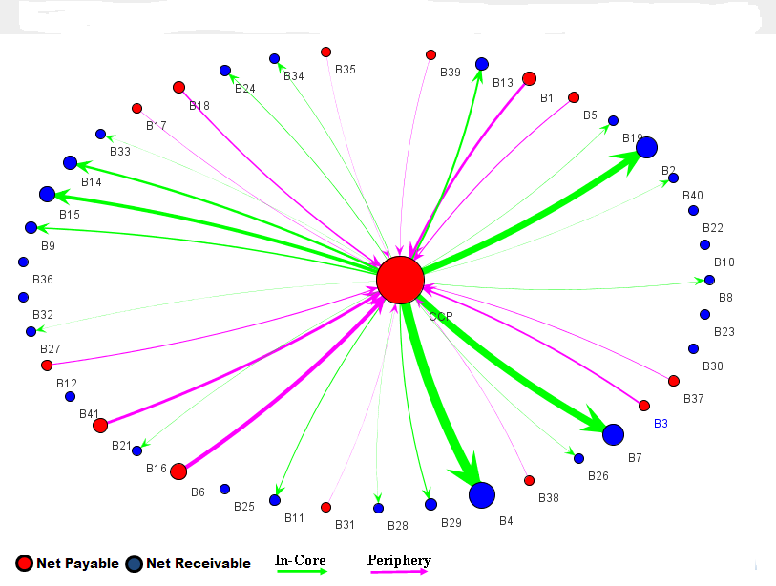
Network Topology : With CCP Penetration
Scenario: 2 Multi-product
Single CCP same % cleared as in Scenario 1
Scenario 1: Extant situation CCP: 75% IR,50%Credit;
20%Commodity;15% Forex
Scenario 4 Nirvana :100% Single CCP for Multiproduct
Scenario 3 100% Cleared
Single Product
CCPs
Scenario 3
Scenario 4 Singl
The colours of the nodes denote whether the financial institution is a net payer (red) or a net receiver (blue) of variation margin, while the size of the arrows linking the nodes is proportional to the size of the exposure between them. Note, CCPs have balanced books CCP 1 :
Notes:
Describe some topological statistical features

Slide 34
The Role of Central Counterparties
CCP assists iin the management of counterparty credit risk by interposing itself between counterparties to become the buyer to every seller, and the seller to every buyer. These arrangements support anonymous trading, deepen market liquidity, and generally maximize the netting of exposures across participants.
clearinghouses are better able to manage risk than dealer banks in the over-the-counter derivatives market, and (2) clearinghouses are better able to absorb risk than dealer banks. Adam J. Levitin
Policymakers acknowledge confidence in underlying markets could be severely tested if a CCP’s activities were disrupted, leaving market participants unable to establish new positions or manage existing exposures.
200
A
B
160
180
C
A
B
40
CCP
20
20
C

Slide 35
Collateral Hungry System In Scenarios 1-3 (Realistic Ones): Creates Tradeoff between Solvency Risk and Liquidity Risk
Replacement cost risk managed through
  Variation margin: exchanged daily usually in cash – to reflect mark-to-market price changes on participants’ outstanding positions.
  Initial margin: to cover, with typically 99% Confidence level
A CCPs initial margin is supplemented with a pool of resources from all participants known as the default fund
Risk to CCP arises from unfunded variation margin of losing side clearing members (viz. in excess of initial margin)
Defaul fund is calibrated to withstand the default of its largest two participants (Cover 2)
CCP transfer shortfalls through Variation Margin Haircuts
to winning side clearing members
Notes:
Initial margin requirements may be met either in cash or using high-quality non-cash assets that carry low credit, market and liquidity risk. Only the defaulted participant’s initial margin can be used in the event of a default.

Slide 36
Collateral Hungry System In Scenarios 1-3 (Realistic Ones): Creates Tradeoff between Solvency Risk and Liquidity Risk
Replacement cost risk managed through
  Variation margin: exchanged daily usually in cash – to reflect mark-to-market price changes on participants’ outstanding positions.
  Initial margin: to cover, with typically 99% Confidence level
A CCPs initial margin is supplemented with a pool of resources from all participants known as the default fund
Risk to CCP arises from unfunded variation margin of losing side clearing members (viz. in excess of initial margin)
Defaul fund is calibrated to withstand the default of its largest two participants (Cover 2)
CCP transfer shortfalls through Variation Margin Haircuts
to winning side clearing members
Notes:
Initial margin requirements may be met either in cash or using high-quality non-cash assets that carry low credit, market and liquidity risk. Only the defaulted participant’s initial margin can be used in the event of a default.

Slide 37
OTC Derivatives Data MAGD(Macroeconomic Assessment Group on Derivatives)
The data consists of reported balance sheet data on derivative assets and liabilities for 41 GSIBs (2012 Financial reports)
Tier 1 capital and liquid resources (defined as the sum of cash, cash equivalents and available-for-sale assets)
($US trillion) | Total | Core (16 Banks) | Periphery (25 Banks)
Derivative Liabilities | 14.34 | 12.16 | 2.18
Derivative Assets | 14.48 | 12.35 | 2.13
Cash and Cash Equivalents | 2.44 | 1.20 | 1.25
Available for Sale Assets | 5.57 | 2.83 | 2.74
Tier 1 Capital | 2.39 | 1.34 | 1.05

Slide 38
OTC Derivatives Data MAGD(Macroeconomic Assessment Group on Derivatives)
The data consists of reported balance sheet data on derivative assets and liabilities for 41 GSIBs (2012 Financial reports)
Tier 1 capital and liquid resources (defined as the sum of cash, cash equivalents and available-for-sale assets)
($US trillion) | Total | Core (16 Banks) | Periphery (25 Banks)
Derivative Liabilities | 14.34 | 12.16 | 2.18
Derivative Assets | 14.48 | 12.35 | 2.13
Cash and Cash Equivalents | 2.44 | 1.20 | 1.25
Available for Sale Assets | 5.57 | 2.83 | 2.74
Tier 1 Capital | 2.39 | 1.34 | 1.05

Slide 39
Netting: Almost a $Trillion worth of initial margin
Netting efficiency depends on the product and counterparty scope of a given clearing arrangement, the profile of positions, and the margining methodology applied:
Initial Margin at 99 Percent Coverage
 | Total | Bank-to-bank | Bank-to-CCP | CCP-to-bank
Scenario 1 | 942.10 | 892.88 | 49.22 | 0.00
Scenario 2 | 930.25 | 892.88 | 37.37 | 0.00
Scenario 3 | 121.82 | 0.00 | 121.82 | 0.00
Scenario 4 | 80.76 | 0.00 | 80.76 | 0.00

Slide 40
Default Fund Size: For each CCP’s default fund in each scenario
($US billion) | Scenario 1 | Scenario 3
CCP1 (Interest Rates) | 3.86 | 5.14
CCP2 (Foreign Exchange) | 0.45 | 3.00
CCP3 (Equity) | 1.63 | 10.83
CCP4 (Credit) | 0.84 | 1.63
CCP5 (Commodity) | 0.17 | 0.87
Total | 6.95 | 21.47
Total encumbrance (default fund and initial margin) | 949.05 | 143.29
 | Scenario 2 | Scenario 4
CCP (Combined) | 4.14 | 11.86
Total encumbrance (default fund and initial margin) | 934.39 | 92.62
Notes:
We calibrate the CCP’s default fund to Cover 2

Slide 41
Systemic Importance and Vulnerability: Scenario 1
Equity and Interest Rate Derivatives CCPs found to be vulnerable
Ranking of institutions can differ in the respective 2.67 and 3.89 price volatility cases; for example, in Figure 5(a), B6 is ranked fourth for the 2.67 standard deviation case, while B4 is ranked fourth for the 3.89 standard deviation case. Eigenvectors normalized to equate highest centrality rank to 1.

Slide 42
Conclusions
Large exposures of CCPs and their extensive interconnections make them systemically vulnerable
CCPs could transmit stress widely through the system in event of extreme shock : Cover 2 not adequate and suffers from procyclicality
Scenario 1 most closely describes the topology that is likely to be observed in the near term
Our analysis underscores importance of understanding the stability of networks in which central clearing and non-central clearing co-exist. In such a scenario, the interaction between liquidity and solvency risks is important.
The heavy liquidity encumbrance of GSIBs from CCP clearing has macro-economic implications
Future research needed to quantify ‘skin in game ‘ capital requirements on CCPs

Slide 43
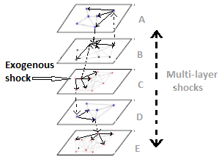
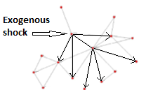
A Financial Intermediary is member of multiple financial markets (multi-layer networks) How to calculate its centrality across the different networks it is present ?Joint Eigen-vector centrality
Single network
Multi-Layer Network with common nodes in some layers ; m markets

Slide 44
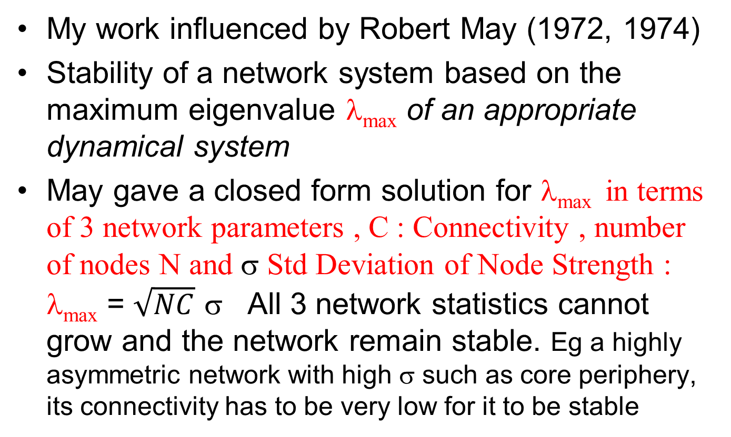
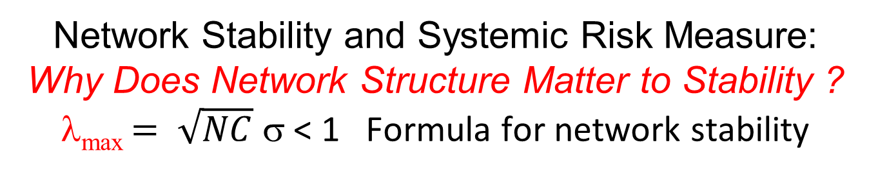
Network Stability and Systemic Risk Measure: Why Does Network Structure Matter to Stability ? λ_{max} $= \sqrt{NC}$σ< 1 Formula for network stability
My work influenced by Robert May (1972, 1974)
Stability of a network system based on the maximum eigenvalue λ_{max}of an appropriate dynamical system
May gave a closed form solution for λ_{max} in terms of 3 network parameters , C : Connectivity , number of nodes N and σ Std Deviation of Node Strength : λ_{max}= $\sqrt{NC}$σ All 3 network statistics cannot grow and the network remain stable. Eg a highly asymmetric network with high σ such as core periphery, its connectivity has to be very low for it to be stable

Slide 45
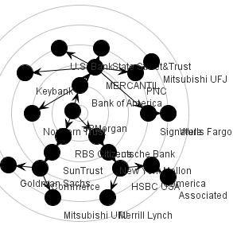
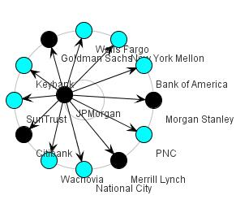
Contagion when JP Morgan Demises in Clustered CDS Network 2008 Q4 ( Left 4 banks fail in first step and crisis contained) v
In Random Graph (Right 22 banks fail !! Over many steps)
Innoculate some key players v Innoculate all ( Data Q4 08)

Slide 46
Complexity Economics

Slide 47
ADAPTIVE NOVELTY :
INNOVATION, PROTEANISM , HYPER INTELLIGENCE
•First modern study of capacity of systems to produce ‘new’ objects :
von Neumann in the 1940s with his self-reproducing machines.
Provenance of Langston/Casti/Wolfram/Chomsky agents of computational powers of Turing Machines are needed to produce Type 4 dynamics with structure changing undecidable dynamics based on novelty and surprises they call the sine qua non of complex adaptive systems (see, Economist , Peter Albin, 1998)
• Capacity to produce novelty, ‘new’ objects is rampant in market systems, evolutionary immune systems with host parasite relationships and other evolutionary systems. 2007 crisis could not handle radical uncertainty from rampant innovations in monetary and financial systems that undermined economic stability (Andrew Haldane)
•In extant economic and game theory, the mathematical framework used is inadequate to model innovation as arising from strategic necessity in a Nash equilibrium of a game. Mutation is taken to be random and the ESS equilibria study how systems can be locked in and be resistant to mutants who arise in an exogenous way. Herbert Simon said to me ( re game theorists) : Randomize too much, don’t they ?
• NEO-DARWINIAN TRADITION POSTULATES INNOVATION ARISES ONLY FROM RANDOM MUTATION ON WHICH NATURAL SELECTION OPERATES

Slide 48
●Binmore (1987) : Modelling Rational Players (Journal of Economics and Philosophy) Seminal work that introduced to game theory the requisite dose of mechanism with players with powers of Turing machines, and along with it ‘the spectre of Gödel’. “What of the Liar ?”
Binmore’s critique of traditional game theory is that it cannot accommodate a generic model of a rule breaker that comes in the form of Gödel’ s Liar which formalizes the structure of opposition.
● F.A Hayek influenced me on the limits on constructive reason and on Godel type cognitive incompleteness

Slide 49
“Bacterial wisdom, Gödel's theorem and creative genomic webs” Eshel Ben Jacob (1998); Markose (2005) Economic Journal paper on Markets as Complex Adaptive Systems
Ben-Jacob : The emergence of new forms or entities not previously there “ this is not the result of successful accumulation of mistakes ( or random mutations) in the replication of the genetic order”. The genome even in most early life forms such as in bacteria already has endogenous ‘creative’ capabilities and does not have to rely only on random mutations enhanced by natural selection to evolve.
Ben-Jacob gives a number of capabilities that the ‘genome units’ should possess (p59) to be able to engineer, possibly as emergent outcomes, novel artifacts and behaviours:
(i)Capacity to recognize difficulties in the environment or hostile conditions that is a threat to some functionality ,
(ii) The need for advanced language that includes self-referential mapping.
Finally and significantly,
(iii) Even with very earliest form of life as with bacteria, they evolved social capabilities of recognizing signals between self and the other (bottom of p 63) which requires a rich (chemical) language.
(ii) and (iii) we will call meta-analysis.

Slide 50
To Date Game Theory Eschews Possibility of an Agent Considering a ‘Surprise’ or ‘Novel’ Action and in turn that he will be ‘Surprised’ and Face a Non-Listed Action
The main point of departure between extant game theory and the above Gödelian logic of agents capable of meta-analysis has been succinctly stated by Bhatt and Camerer (2005) as follows: “in a Nash equilibrium nobody is surprised about what others actually do, or what others believe, because strategies and beliefs are synchronized, presumably due to introspection, communication or learning.”
What is missing in this statement is the characterization of a Nash equilibrium in which players mutually and logically expect that they will need to surprise and be surprised in that novel actions follow.
Markose (2013/15) paper is concerned with extending game theory to incorporate social proteanism : A Nash equilibrium in which agents are involved in a arms race of competitive innovation.

Slide 51
Concluding Remarks
ACE is an exciting new field to get into, essential for the 21 st century
You need to combine programming and Computer Science knowledge with Economics and Finance
Current REF climate in UK does not permit such developments as ACE is not mainstream and cannot make it into
Policy makers require urgent access to such tools but academic economists in UK are unable to deliver unless there is new training

Slide 52
ACE Micro-Economics ; Complexity Economics References
Markose S., Alentorn A., Koesrindartoto D., Allen P., Blythe P. and Grosso S., 2007, “A smart market for passenger road transport (SMPRT) congestion: An application of computational mechanism design ”, Journal of Economic Dynamics and Control , Volume 31, Issue 6, June 2007, Pages 2001-2032 , ISSN: 0165-1889.
Markose S., Amadeo Alentorn and Andreas Krause Dynamic Learning, Herding and Guru Effects in Networks (PDF 1.2 MB) , Sept 2004, The paper is also an Economics Department Working Paper, No. 582, Sept 2004.
Markose, S., J. Arifovic and S. Sunder, 2007, “Advances in Experimental and Agent-based Modelling: Asset Markets, Economic Networks, Computational Mechanism Design and Evolutionary Game Dynamics ” ,Journal of Economic Dynamics and Control, Volume 31, Issue 6, pages 1801-1807. Full Text + Links | PDF (124 K)
Markose, S.M, 2005 , “Computability and Evolutionary Complexity : Markets as Complex Adaptive Systems (CAS)”, Economic Journal ,vol. 115, pp.F159-F192. ISSN 0013-0133
CCPs and Network Stability in OTC Derivative Markets
Alex Heath, Gerard Kelly, Mark Manning, Sheri Markose and Ali Rais Shaghaghi , Under Review Journal of Financial Stability

Slide 53
References Macro Prudential :
(1) Markose, S.M (2013) "Systemic Risk Analytics: A Data Driven Multi-Agent Financial Network (MAFN) Approach", Journal of Banking Regulation , Vol.14, 3/4, p.285-305, Special Issue on Regulatory Data and Systemic Risk Analytics.
(2) Markose, S. (2012) “Systemic Risk From Global Financial Derivatives: A Network Analysis of Contagion and Its Mitigation With Super-Spreader Tax”, November, IMF Working Paper No. 12/282,
(3) Markose, S., S. Giansante, and A. Shaghaghi, (2012), “Too Interconnected To Fail Financial Network of U.S. CDS Market: Topological Fragility and Systemic Risk”, Journal of Economic Behavior and Organization, Volume 83, Issue 3, August 2012, P627-646
http://www.sciencedirect.com/science/article/pii/S0167268112001254
(3)Multi-Agent Financial Network (MAFN) Model of US Collateralized Debt Obligations (CDO): Regulatory Capital Arbitrage, Negative CDS Carry Trade and Systemic Risk Analysis, Sheri M. Markose, Bewaji Oluwasegun and Simone Giansante, Chapter in Simulation in Computational Finance and Economics: Tools and Emerging Applications Editor(s): Alexandrova-Kabadjova B., S. Martinez-Jaramillo, A. L. Garcia-Almanza, E. Tsang, IGI Global, August 2012.
http://www.acefinmod.com/CDS1.html

