Slide 1

Financial Decisions and Information Networks among Female-headed Households
Udichibarna Bose*, Thankom Arun* and Shoba Arunª
* University of Essex, United Kingdom
ª Manchester Metropolitan University, United kingdom
Essex Conference on Financial Inclusion 2020
6th November 2020

Slide 2
Media and Social Networks
Making informed financial decisions remains a challenge for large parts of the population across the world (Lusardi and Mitchell, 2007; Lusardi et al., 2010).
Evidence suggests that when the target audience is large, harnessing the media and social networks can prove to be an effective tool in raising awareness and changing attitudes (Atkinson and Messy, 2013).
Mass media (Berg and Zia, 2017) and social interactions (Duflo and Saez, 2003) offer a powerful platform for communicating educational information and influencing behaviour.

Slide 3
Mediating role of financial expertise
Irrespective of the fact that information networks can enhance the quality of decision-making among individuals, the success of education programmes may be limited if programmes fail to provide goal-orientated information (Braunstein and Welch, 2002).
Studies show that financial experience makes people more receptive to financial education programmes, and thus helps to improve their financial literacy and financial behaviour (Mandell 2008; Frijns et al., 2014).
Thus, we argue that households with financial expertise are more likely to recognise the value and better utilise the financial information provided by media and social networks in making more informed and profitable financial decisions.

Slide 4
Why it is important to focus on female-headed households?
Female-headed households are triply disadvantaged due to the burdens of poverty, gender discrimination, and absence of support as heads of household (Buvinic and Gupta, 1997).
Women who head households may face discrimination in accessing jobs or resources because of their gender, social or economic factors, which further affects their household's economic welfare.
In the context of India, female-headed households pay nearly 5 percentage points higher interest cost and have 7–10 percentage points lower access to formal sources of finance as compared with male headed households (Rajeev and Bhattacharjee; 2012, 2015).
Recent studies show the continuing differential vulnerability of female-headed households due to limited mobility, connectivity and access to protective social networks, jeopardizing their engagement in income generation activities (Flato et al., 2017).

Slide 5
Objectives of the paper
To study the direct impact of information networks such as media and digital networks and social networks on the financial returns of the female-headed households.
To study the influence of these information networks on the financial behaviour of households separately in urban and rural areas.
To explore the mediating role of financial expertise in the relationship between information networks and financial decisions.

Slide 6
Contribution
To the best of our knowledge, this is the first paper that focuses on the mediating role of financial expertise in the relationship between information networks and financial returns of households.
We study the impact of information networks on households’ financial decisions in a setting of an emerging economy, whereas most studies focus on developed countries (Cole et al., 2011).
We investigate the direct relationship between information networks such as media networks and social networks and financial returns among the vulnerable groups of female-headed households in both urban and rural sectors of India.

Slide 7
Data
Data sources
India Human Development Survey (IHDS) – Second round of IHDS which was conducted in 2011-12.
This is a unique nationally representative, multi-topic survey of Indian households in 1503 villages and 971 urban neighbourhoods.
We rely on a sample of 37,964 household that are female-headed and use the ‘self-reporting’ definition of ‘female-headed’ as adopted in the available data sources.

Slide 8
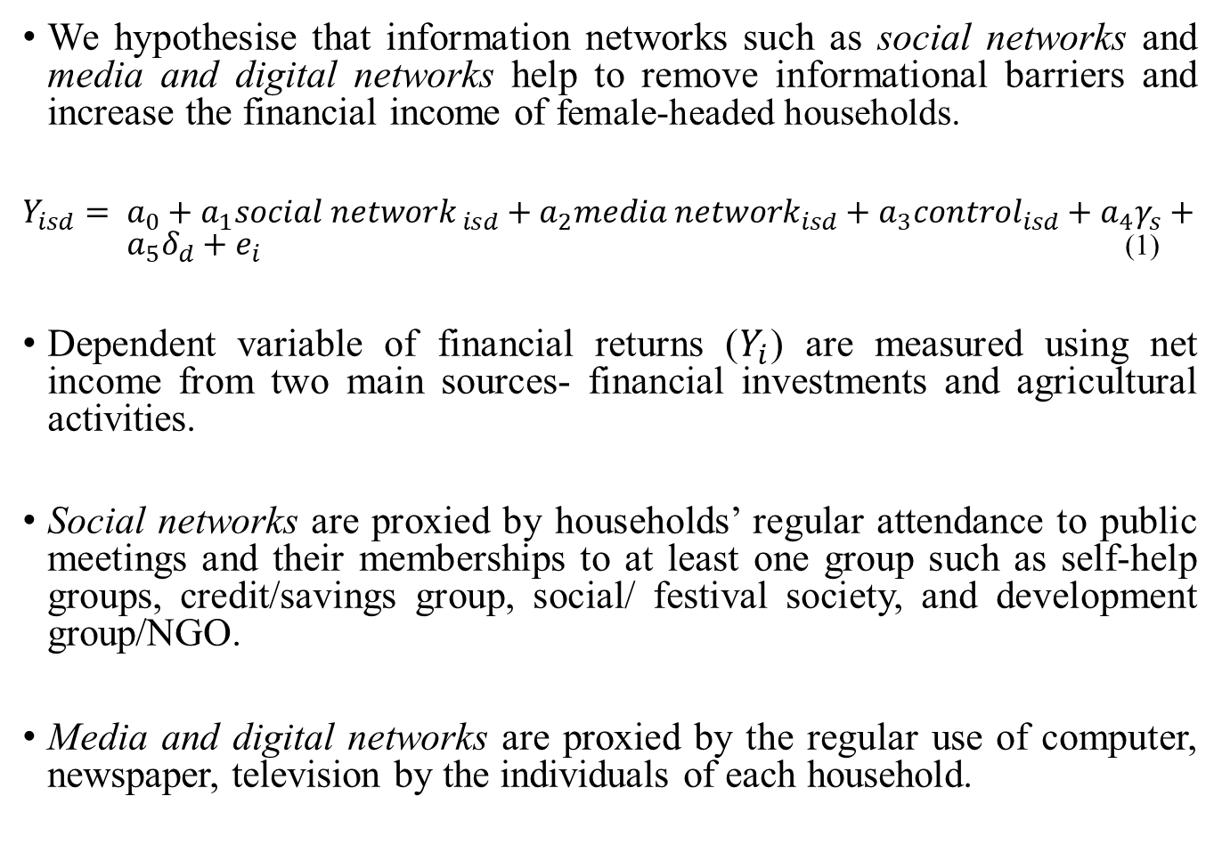
Baseline Model
We hypothesise that information networks such as social networks and media and digital networks help to remove informational barriers and increase the financial income of female-headed households.
$Y_{isd}= a_{0}+a_{1}{social network}_{ isd}+a_{2}{media network}_{isd}+a_{3}{control}_{isd}+a_{4}γ_{s}+{ a}_{5}δ_{d}+e_{i}$ (1)
Dependent variable of financial returns ($Y_{i}$) are measured using net income from two main sources- financial investments and agricultural activities.
Social networks are proxied by households’ regular attendance to public meetings and their memberships to at least one group such as self-help groups, credit/savings group, social/ festival society, and development group/NGO.
Media and digital networks are proxied by the regular use of computer, newspaper, television by the individuals of each household.

Slide 9
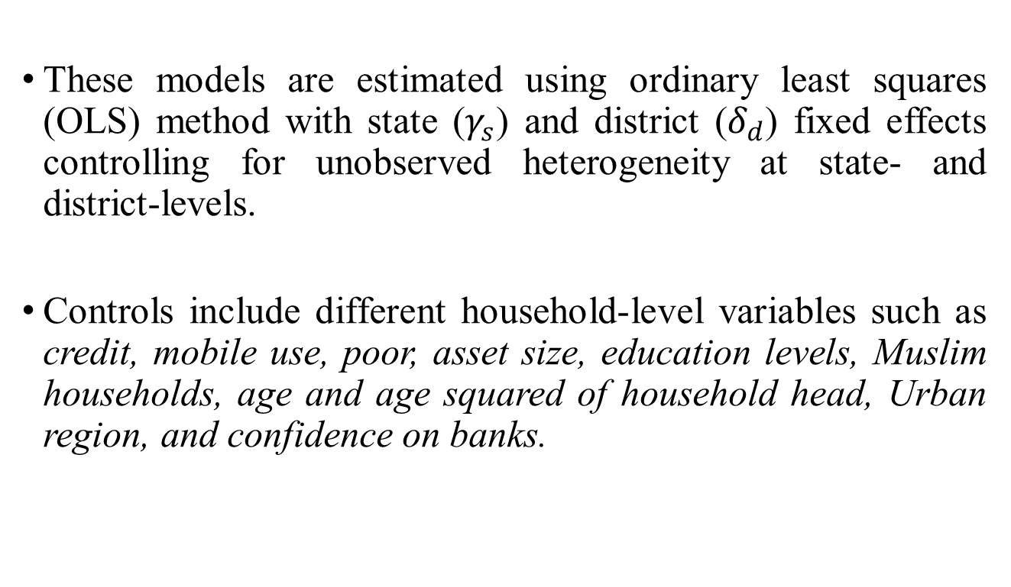
Baseline Model
These models are estimated using ordinary least squares (OLS) method with state ($γ_{s}$) and district ($δ_{d}$) fixed effects controlling for unobserved heterogeneity at state- and district-levels.
Controls include different household-level variables such as credit, mobile use, poor, asset size, education levels, Muslim households, age and age squared of household head, Urban region, and confidence on banks.

Slide 10
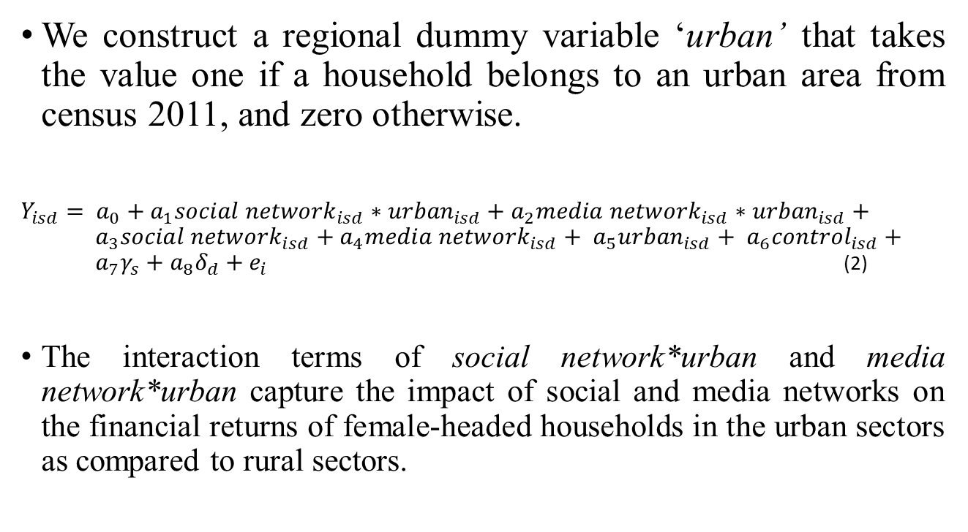
Accounting for regional heterogeneity
We construct a regional dummy variable ‘urban’ that takes the value one if a household belongs to an urban area from census 2011, and zero otherwise.
$Y_{isd}= a_{0}+a_{1}{social network}_{isd}∗{urban}_{isd}+a_{2}{media network}_{isd}∗{urban}_{isd}+ a_{3}{social network}_{isd}+a_{4}{media network}_{isd}+ a_{5}{urban}_{isd}+ a_{6}{control}_{isd}+ a_{7}γ_{s}+a_{8}δ_{d}+e_{i}$ (2)
The interaction terms of social network*urban and media network*urban capture the impact of social and media networks on the financial returns of female-headed households in the urban sectors as compared to rural sectors.

Slide 11
Mediating role of financial expertise
We classify our female-headed households into two groups, namely households with financial expertise and households without financial expertise.
Following Frijns et al., (2014) and Lusardi and Tufano (2015), we define financial experience based on individuals’ reported experiences with traditional saving, investing and payment activities for each household.
We construct a dummy variable for ‘financial expertise’ which takes value of one if individuals in a household has either bought securities in mutual funds, individual stocks and bonds, invested in fixed deposits and gold, or opened a bank savings or current account in the past five years without suffering any large amount of losses, and zero otherwise.

Slide 12
Summary statistics
Households with financial expertise are more likely to higher financial returns, better information networks, higher access to credit, better financial and education levels as compared to households without financial expertise.
Urban households have higher financial income but lower agricultural income, higher financial expertise and media networks followed by better financial and education levels as compared to rural households.

Slide 13
Summary statistics

Slide 14
Results- Information networks, financial expertise and financial behaviour
The results show a positive and significant of both social and media networks on net financial income and agricultural income.
Taking into account the role of financial expertise, we find the positive and significant impact of information networks on financial returns for the households with financial expertise, while it is insignificant for the households without financial expertise.

Slide 15
Results- Information networks, financial expertise and financial behaviour

Slide 16
Results- Regional heterogeneity in information networks and financial expertise
We find a positive and significant effect of both ‘social network*urban’ and ‘media network*urban’ on net financial income, and negative and significant effect on net agricultural income.
We again find a positive and significant impact of information networks on financial income of the households with financial expertise in urban sectors, while it is insignificant for the households without financial expertise.
While, find a negative and significant impact of information networks on agricultural income for the households with financial expertise in urban sectors, while it is insignificant for the households without financial expertise.

Slide 17
Results- Regional heterogeneity in information networks and financial expertise

Slide 18
Robustness tests
Instrumental variable method- Endogeneity concerns arising due to unobservable factors and reverse causality are corrected using the two-staged least squares (2SLS) method.
Alternative mediation test for financial expertise- We analyse the mediation effect of financial expertise using Baron and Kenny's (1986) mediation test which is the most widely-used method for testing mediation hypotheses.

Slide 19
Conclusion
The results confirm a positive effect of information networks on households’ net income from financial and agricultural investments in both urban and rural sectors.
We find that the positive relationship between information networks and financial behaviour is only significant for the female-headed households with financial expertise, confirming the mediating role of financial expertise.
Thus, media and social networks indeed has the power to capture the attention of masses unlike any other medium, and thereby provide policy makers with an effective tool to deliver carefully designed educational messages on social, financial and health issues.
These networks particularly have the potential to empower women both individually and collectively, which may lead to better awareness and financial well-being.

