Slide 1
Is your Household a Small Business?
Diogenis Baboukardos & Silvia Gaia

Slide 2
Why are we here for?
This is an attempt to familiarise the public with the main concepts of accounting and how these concepts can be applied using bank statements and make our daily life easier.
2

Slide 3

Accounting: A necessary evil?
Accounting is not only for businesses
and tax authorities
  How much money did you make in a year?
  How much money did you spend in a year? How much did you spend for food? How much for clothes? How much for leisure activities?
  What are the values of your possessions?
  How much do you need to save annually in order to replace your car?
3

Slide 4

Accounting: A necessary evil?
Accounting is not only for businesses
and tax authorities
  How much money did you make in a year?
  How much money did you spend in a year? How much did you spend for food? How much for clothes? How much for leisure activities?
  What is the values of your possessions?
  How much money should you spend for your new refrigerator?
  How large can be your monthly instalments for your loan payment?
  How much do you need to save annually in order to replace your car?
HOW CAN A BANK ACCOUNT HELP ME MANAGE THE FINANCIALS OF MY HOUSEHOLD?
Accounting will provide an answer to all these questions
4

Slide 5

Main Elements of Financial Statements
Assets
Capital / Equity
Liabilities
Revenue
Expenses
Balance sheet
Resources available to a business
Amount owed by a business to owner(s)
Amount owed by a business to other
What the business earns from the sale of goods or provision of services
What it costs the business to earn the income
Income statement
5

Slide 6
Main Elements of Financial Statements
Assets
Capital / Equity
Liabilities
Revenue
Expenses
Resources available to a business
Amount owed by the business to the owner(s)
Amount owed by the business to other(s)
What the business earns from the sale of goods or provision of services
What it costs the business to earn the income
Income statement
6

Slide 7
Main Elements of Financial Statements
Assets
Capital / Equity
Liabilities
Revenue
Expenses
Resources available to a business
Amount owed by the business to the owner(s)
Amount owed by the business to other(s)
What the business earns from the sale of goods or provision of services
What it costs the business to earn the income
7

Slide 8
Basic Format of Balance Sheet
Amounts in £ | 2016 | 2015
Assets
Land | 2 874 | 3 771
Property, plant and equipment | 17 900 | 18 687
Inventories | 2 430 | 2 957
Cash and cash equivalents | 3 082 | 2 165
Total Assets | 26 286 | 27 580
Equity & Liabilities
Trade and other payables | 8 568 | 9 922
Borrowings | 10 711 | 10 651
Share capital | 7 007 | 7 007
Total Equity & Liabilities | 26 286 | 27 580
What do I have?
To whom do I owe
what I have?
8

Slide 9
Basic Format of Income Statement
Amounts in £ | 2016 | 2015
Income (revenues, rent, other income) | 54 433 | 59 925
Less Cost of sales | (51 579) | (59 128)
Less expenses (e.g. utilities, rent) | (1 852) | (574)
Less Finance costs | (892) | (151)
Taxation | (54) | (30)
Net Profit | 60 | 46
How much money did
I make this year?
How much did I spend?
Bottom line
9

Slide 10
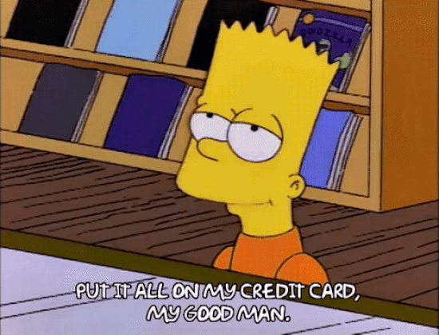
Bank account and Accounting
A bank account…
allows you to track your economic transactions
check how much you spent on what
plan the future

Slide 11
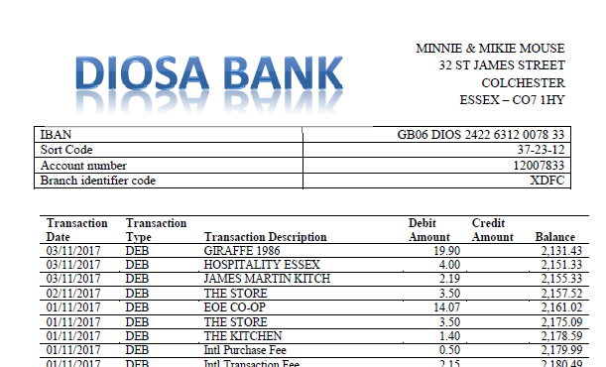
Accounting for a household
11

Slide 12
Accounting for a household
Initial contribution (equity)
Transaction Date | Transaction Type | Transaction Description | Debit Amount | Credit Amount
29/08/2017 | TFR | BANK TRANSFER FROM MICKIE |  | 2,000.00
29/08/2017 | TFR | BANK TRANSFER FROM MINNIE |  | 3,000.00
12

Slide 13
Accounting for a household
Long term assets
  Sofa
  Double bed
  Dinning table with chairs
  Coffee table
  TV set
  Wardrobe
Transaction Date | Transaction Type | Transaction Description | Debit Amount | Credit Amount
29/08/2017 | DEB | IKEA | 2,987.00
13

Slide 14
Accounting for a household
Long term assets
  Depreciation
    In how many years am I planning to replace my furniture?
Transaction Date | Transaction Type | Transaction Description | Debit Amount | Credit Amount
29/08/2017 | DEB | IKEA | 2,987.00
14

Slide 15
Accounting for a household
Expenses
Transaction Date | Transaction Type | Transaction Description | Debit Amount | Credit Amount
07/09/2017 | DEB | EOE CO-OP | 19.97
06/09/2017 | DEB | EOE CO-OP | 33.40
05/09/2017 | DEB | EE TOP UP VESTA | 10.00
04/09/2017 | DEB | Amazon UK Retail | 35.99
04/09/2017 | DEB | Amazon UK Marketpl | 26.02
01/09/2017 | DEB | Amazon UK Marketpl | 5.79
01/09/2017 | DEB | RYANAIR 224000 | 130.78
01/09/2017 | DD | SKY DIGITAL | 18.99
29/08/2017 | DEB | ANGLIAN WATER | 65.12
29/08/2017 | DD | COLCHESTER BC CTAX | 81.95
15

Slide 16
Accounting for a household
Income
Transaction Date | Transaction Type | Transaction Description | Debit Amount | Credit Amount
28/09/2017 | TFR | SALARY PAID TO MICKIE |  | 1,000.00
28/09/2017 | TFR | SALARY PAID TO MINNIE |  | 1,000.00
16

Slide 17
Accounting for a household
Additional contribution (equity)
Transaction Date | Transaction Type | Transaction Description | Debit Amount | Credit Amount
18/09/2017 | TFR | BANK TRANSFER FROM MINNIE |  | 300.00
17

Slide 18
Accounting for a household
Long term loan (liabilities)
Transaction Date | Transaction Type | Transaction Description | Debit Amount | Credit Amount
22/10/2017 | LOAN | CONSUMER LOAN 5% IR |  | 12,000.00
18

Slide 19
Task
What do they own?
How much do they owe to others?
How much have they contributed themselves?
How much money did they make?
How much did they spend on:
  Grocery
  Leisure
  Rent
  Travel
  Utilities
Prepare the M&M’s balance sheet and income sheet
19

Slide 20
Task
BALANCE SHEET
ASSETS
Vehicles | 13,000.00
- depreciation | -433.33
Net value of Vehicles |  | 12,566.67
Furniture | 2,987.00
- depreciation | -165.95
Net value of Furniture |  | 2,821.06
Cash |  | 2,131.43
TOTAL ASSETS |  | 17,519.15
LIABILITIES & EQUITIES
Loan |  | 12,000.00
Capital |  | 6,300.00
Retained earnings |  | -780.85
TOTAL LIAB & EQUITY |  | 17,519.15
INCOME STATEMENT
Income Mickey | 2,000.00
Income Minnie | 2,000.00
Operating Expenses
Grocery | - 339.49
Leisure | - 668.86
Rent | -1,650.00
Travel | - 991.38
Utilities | -531.84
Depreciation | -599.28
Net Profit/Loss | -780.85
20

Slide 21
Q&As
Is your Household a Small Business?
Diogenis Baboukardos & Silvia Gaia

